Slide 1
AI Tools Workshop
Dr. Jack Francis, MA-14 #BestClassEver
AI Solutions Director
Davidson Technologies

Slide 2
Agenda
AI Buzz: What is AI and Why now?
Brief introduction to Large Language Models
Improving your ChatGPT usage
Other AI tools to level up your work
Q&A

Slide 3




AI Buzz
AI is about teaching computers to do things that normally require humans
Sudden explosion caused by:
  Big Data
  Powerful Computing
  Smarter Algorithms

Slide 4
AI Buzz
AI is about teaching computers to do things that normally require humans
Sudden explosion caused by:
  Big Data
  Powerful Computing
  Smarter Algorithms
Other categories we won’t cover today:
Drug discovery (AlphaFold)
Fraud detection (Supervised Machine Learning)
Algorithmic Trading (Reinforcement Learning)
Supply chain optimization (Optimization)
Object Detection (Computer Vision)
Personalized Recommendation (Recommendation Engines)

Slide 5
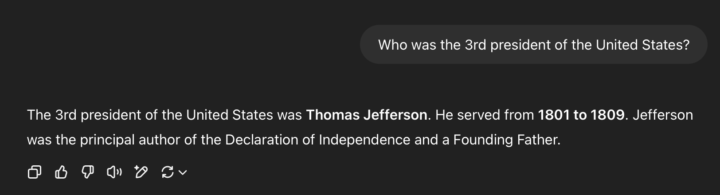
Large Language Models
Large Language Models (like ChatGPT) understand and generate human-like text
Prompts are the instructions/questions you provide to ChatGPT
Prompt
Response / Output
Context
Window
Higher quality prompts lead to higher quality responses / output

Slide 6

Prompting Strategies to Enhance ChatGPT
Be Clear, Be Specific
Use Instructions and Define the Task
Use Role-Based Prompting
Show, Don’t Just Tell
Explain Your Reasoning
Iterate and Refine
Make the LLM Ask You Questions
Specify Your Desired Output

Slide 7
Tip 1: Be Clear, Be Specific
LLMs use available context to predict the best response to your prompt.
Clearer and specific prompts will generate higher-quality outputs
Original Prompt:
“Write about Project Management”
Improved Prompt:
"Explain the key benefits of Agile project management for a software development team new to the methodology. List 3-5 main advantages."

Slide 8
Tip 2: Use Instructions and Define the Task
Use strong action verbs when prompting LLMs (e.g., Write, Summarize, Explain, etc.)
Break down complex requests into smaller, instructed steps
Specify constraints for the task
Original Prompt:
“Can you give me some marketing ideas”
Improved Prompt:
"Generate 5 creative marketing slogans for a new eco-friendly coffee cup. Each slogan should be under 10 words and highlight its reusable nature. Exclude any mention of price.”

Slide 9
Tip 3: Use Role-Based Prompting to Shape Outputs
By telling an LLM to “act as a <insert persona>”, the output will match the tone and style of that persona.
A few specific examples are “act as a teacher”, “act as a critical reviewer”, “act as a job interviewer”
Original Prompt:
“Explain the concept of blockchain”
Improved Prompt:
”Act as a financial advisor for beginners. Explain the concept of blockchain in simple terms, highlighting its potential relevance to personal investing”

Slide 10
Tip 4: Show, Don’t Just Tell: Few-Shot Prompting
Terminology:
  Zero-Shot: Don’t provide any examples (all prompts we’ve done so far)
  Few-Shot: Provide LLM examples of expected output
Providing examples of how you want the LLM to respond is highly effective in shaping the output
Most useful for specific requests, ensuring LLM follows custom output formats, and tone replication

Slide 11
Tip 4: Example
Original Prompt:
“Summarize the key sentiment of this review. ‘The product arrived on time as described’.”
Improved Prompt:
“Summarize the key sentiment of the following customer reviews. Sentiment should be Positive, Negative, or Neutral.
Review: 'The new software update is fantastic and so easy to use!' Sentiment: Positive
Review: 'I'm really disappointed with the battery life on this device.' Sentiment: Negative
Review: 'The product arrived on time as described.' Sentiment: ”

Slide 12
Tip 5: Explain Your Reasoning
Asking the LLM to “think step by step” can lead to more accurate and logical answers, especially for prompts that require multiple steps to get to the expected output.
Note: Most LLMs are trained to do this because it is so effective.
Original Prompt:
“If a train leaves Chicago at 3 PM traveling at 60 mph, and another train leaves Chicago at 4 PM traveling at 70 mph in the same direction, at what time will the second train catch up to the first?”
Improved Prompt:
“If a train leaves Chicago at 3 PM traveling at 60 mph, and another train leaves Chicago at 4 PM traveling at 70 mph in the same direction, at what time will the second train catch up to the first?”. Explain your reasoning step by step

Slide 13
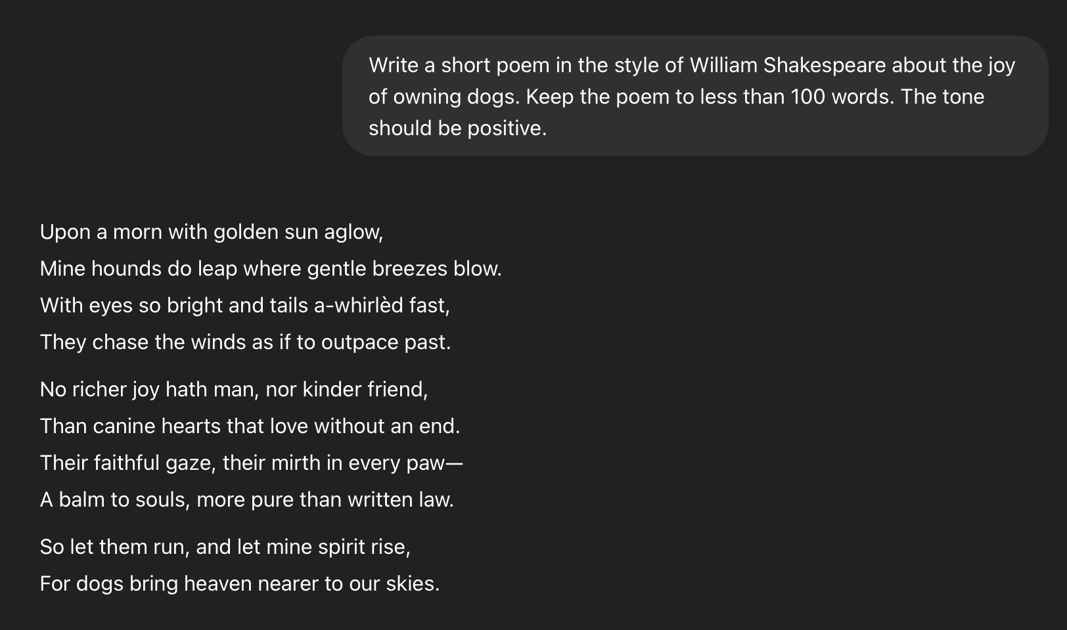
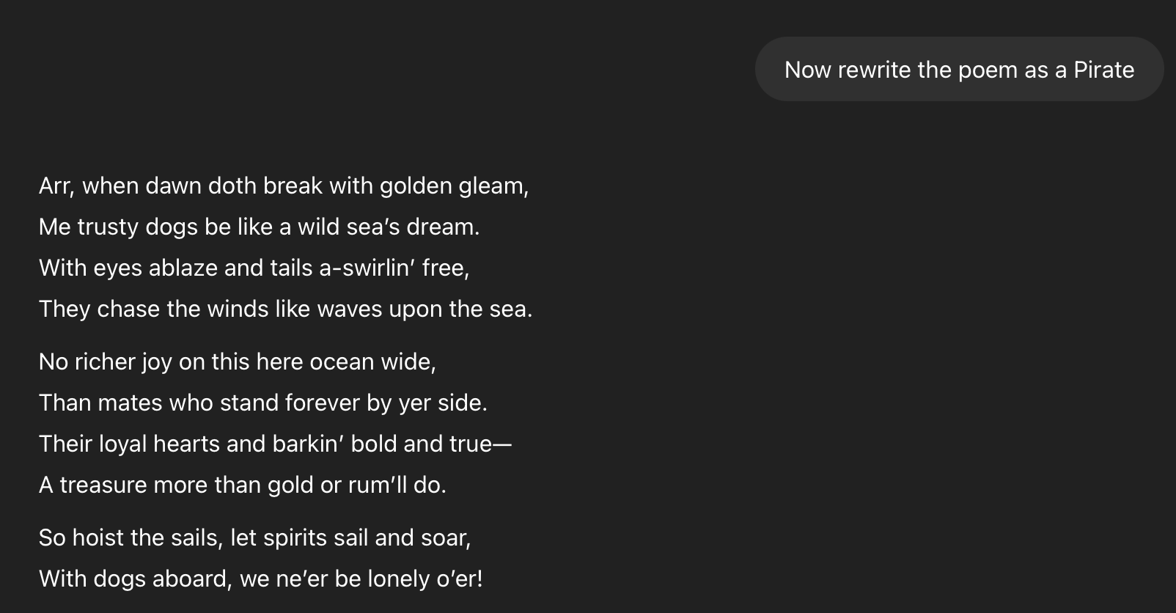
Tip 6: Iterate and Refine
After the first prompt and response, you can shape the LLMs future answers by providing specific guidance
  “Can you make that more concise”, “Rewrite that in a more formal tone”
  “Act as a critic and point out weaknesses in your previous response”
Notes:
Write a short poem in the style of William Shakespeare about the joy of owning dogs. Keep the poem to less than 100 words. The tone should be positive.

Slide 14
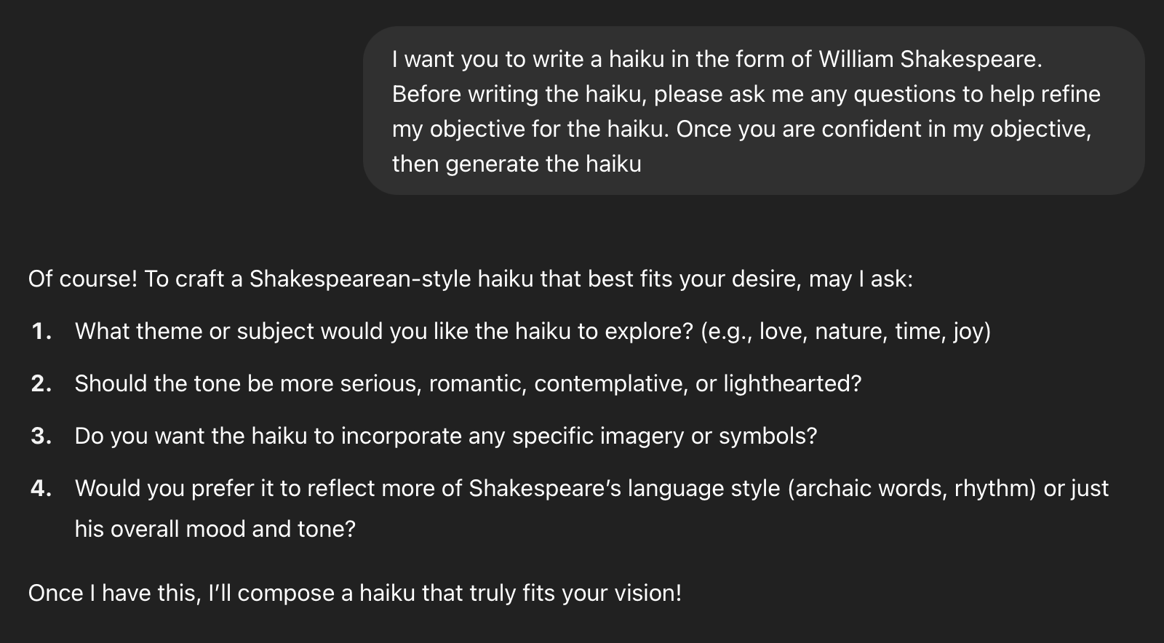
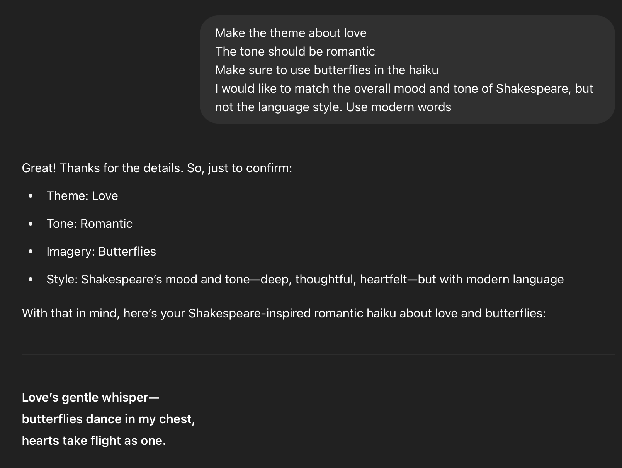
Tip 7: Make the LLM ask you Questions
For complex prompts, ask the LLM to provide you a list of questions to answer before completing the task
This helps provide more specific, clear context to the LLM
Notes:
I want you to write a haiku in the form of William Shakespeare. Before writing the haiku, please ask me any questions to help refine my objective for the haiku. Once you are confident in my objective, then generate the haiku.

Slide 15
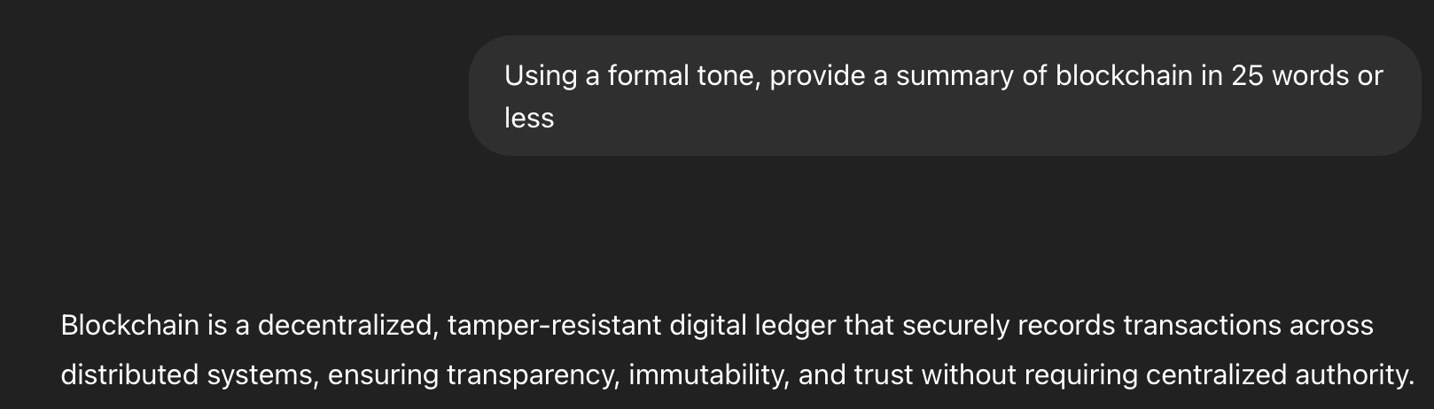
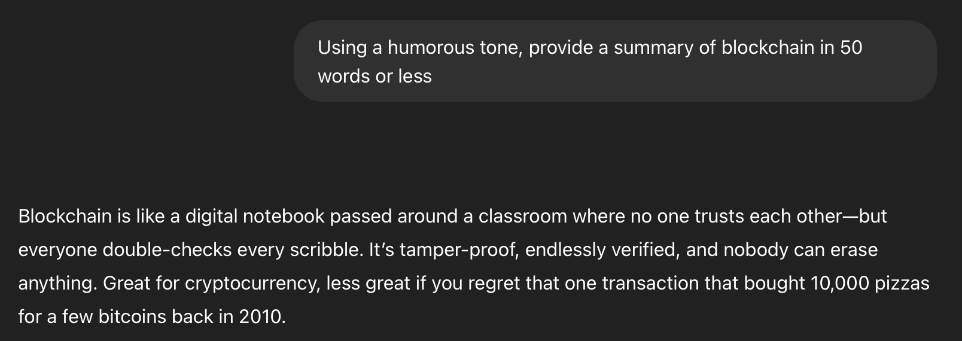
Tip 8: Specify your Desired Output
Be explicit in what you want the LLM to generate
  “Generate a 50 word summary” vs. “Generate a 2 page report”
  “Use a formal tone” vs. “Use a humorous tone”
Notes:
Using a formal tone, provide a summary of blockchain in 25 words or less

Slide 16
AI Tools Buffet
Large Language Models for General Use
Deep Research
Automatic Notetaking
Presentation Generation
Image Generation
Video Generation
Code Generation
Automation
Proposal Generation

Slide 17


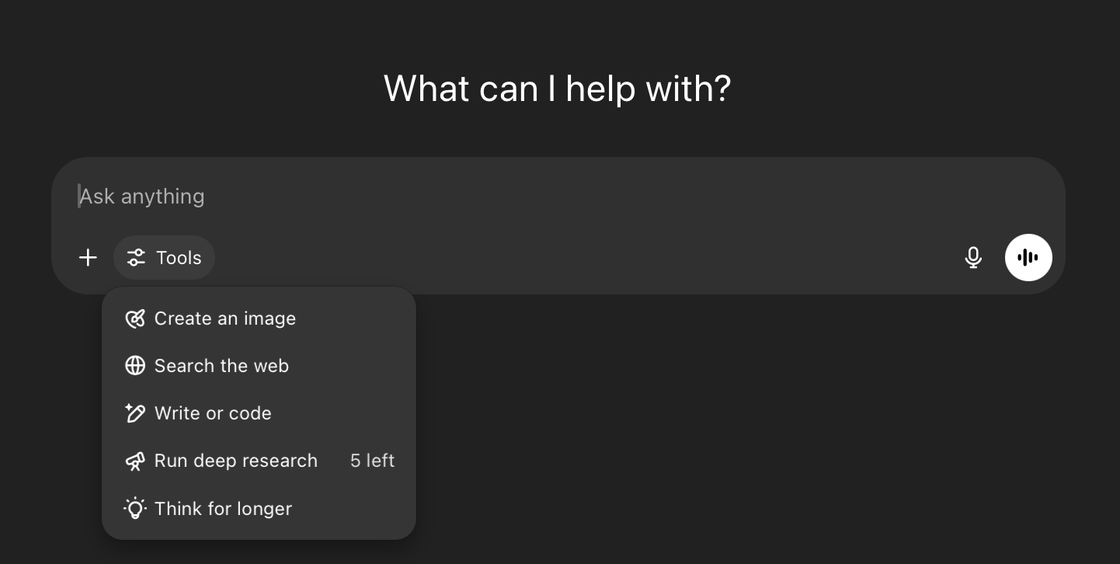
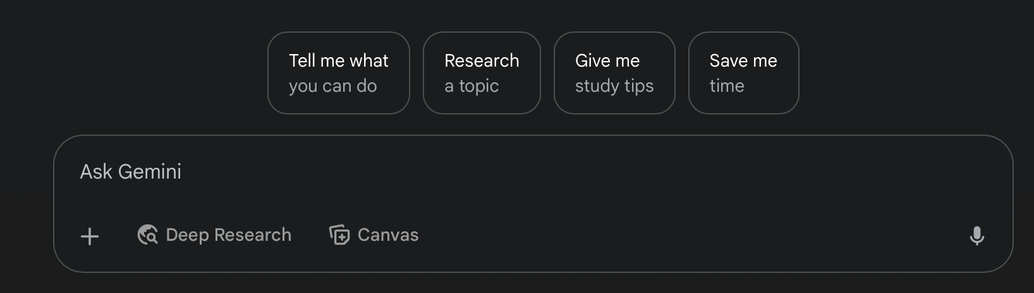
LLMs for General Use (Free Tier)
OpenAI ChatGPT
Google Gemini
For both platforms, on the free tier you get access to image generation, web searches, deep research, and general conversation. However, both have rate limits and use a weaker model.

Slide 18
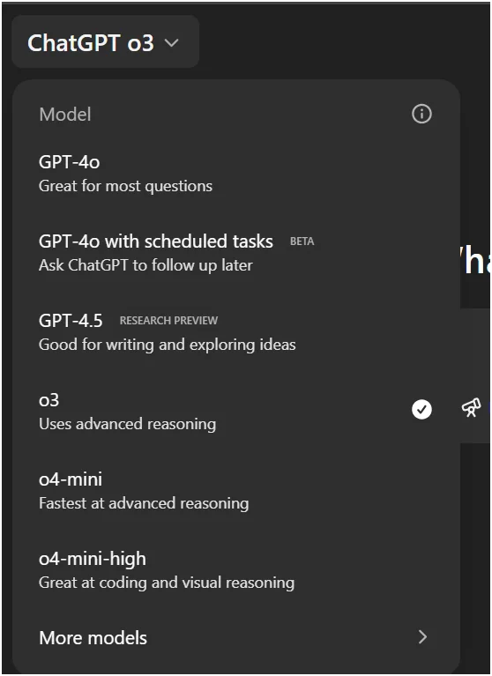
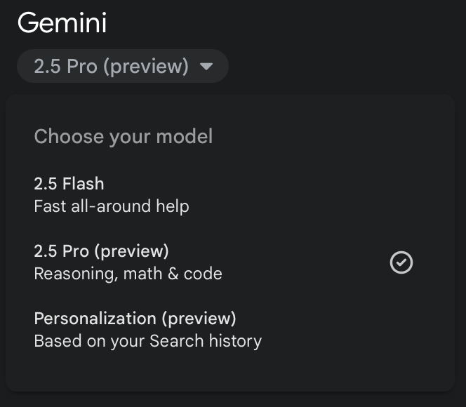
LLMs for General Use (Paid Tier)
Google Gemini
OpenAI ChatGPT
For both platforms, the paid version is $20/month. Highly recommended if you use ChatGPT daily. The improved models are much better than the free tier models

Slide 19
Deep Research
Deep Research is best for complex tasks where you would normally Google multiple times before getting an answer (e.g., planning a trip, doing market analysis, learning about a new customer)
Prompt: “I'm planning to meet with the leadership team of Leadership Greater Huntsville. I don't know much about their organization. Can you identify the leadership team, major initiatives, and programs that Leadership Greater Huntsville runs? What is their mission and vision for the Huntsville community?"
  Example without Deep Research: https://chatgpt.com/share/683f1176-bae8-8011-9acc-48a2063a5343
  Example with Deep Research: https://chatgpt.com/share/683f1143-b634-8011-b63e-e961dcb3c1a8
  Example with Gemini Deep Research: https://g.co/gemini/share/2422229f46e5

Slide 20
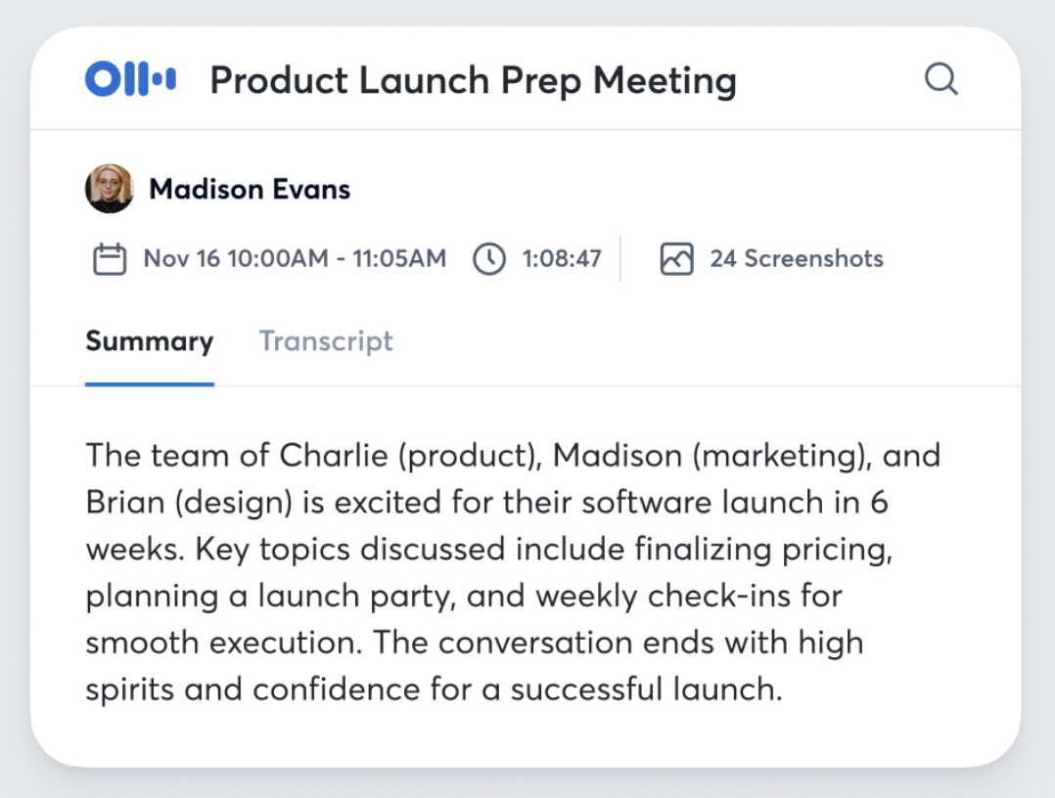
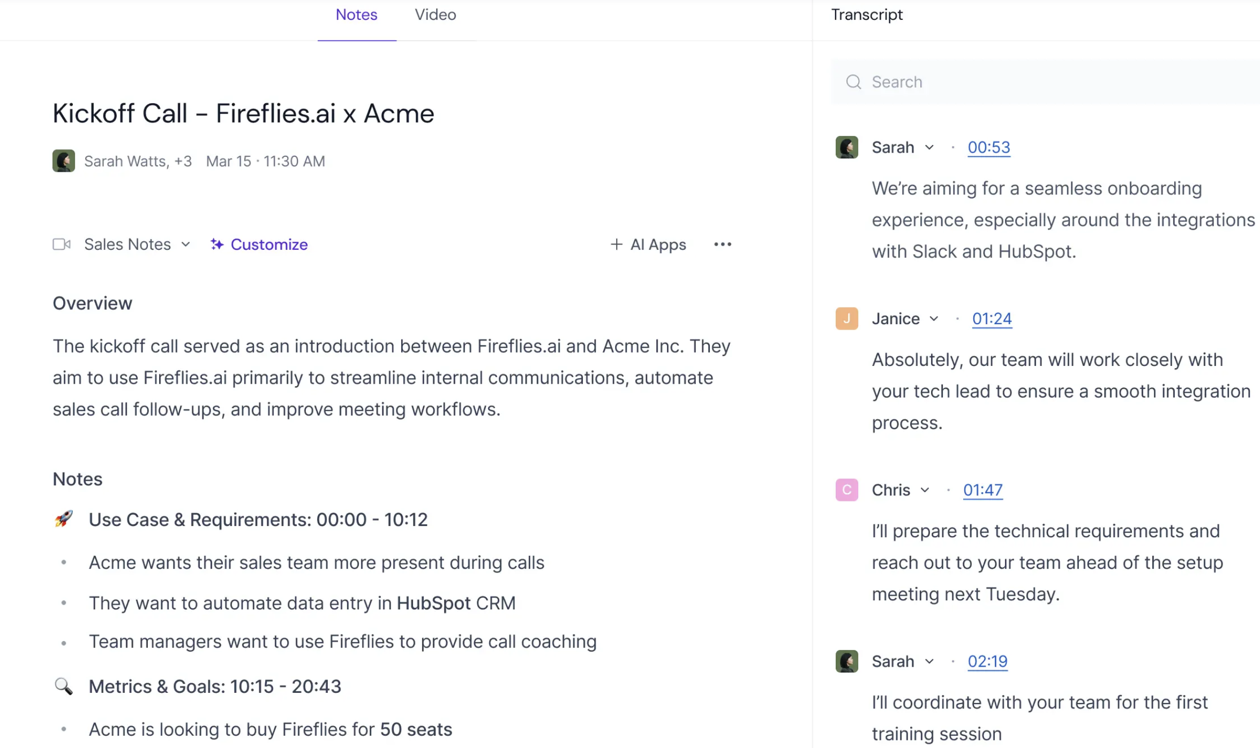
Automated Notetaking
Application joins your Zoom, Google Meet, Teams call to capture notes
Tools provide meeting transcripts, summaries, action items, and attendee lists
Some examples:
  Otter AI (Free and Paid Versions
  Fireflies AI (Free and Paid Versions)

Slide 21
Presentation Generation
Customized, fully generated AI presentations
Example tools
  Beautiful.ai
  Gamma.app
Video available here about halfway down the page:
https://www.beautiful.ai/presentation-maker

Slide 22


Image Generation
Included with ChatGPT and Gemini. For more features use Midjourney
Use same prompt strategies for image generation
Generate an image of a Great Pyrenees laying in the woods. There is a red ball by the dog. It is slightly overcast. The image should be hyperrealistic.
Generate an image of a Great Pyrenees laying in the woods. There is a red ball by the dog. It is slightly overcast. The image should be in an animated cartoon style.

Slide 23
Video Generation
Included with ChatGPT and Gemini Paid Tiers. Some other options, but varied results
AI-Generated video with Google Veo3
https://x.com/nmatares/status/1924931844879134804

Slide 24
Code Generation
Prompt: Write a Python script to play the game snake. Make sure that the snake is green and that the food is an apple. Use the arrow keys to control the snake
LLMs are very, very good at coding.
  Gemini and Claude are the best
Tools for Code Generation
  Github Copilot ($10/month)
  Cursor ($20/month)
As project size grows, LLMs will struggle more because there is so much information to keep in context
More specific tools:
  Website Development: Lovable.dev, Bolt
  Initial MVP development: Replit, v0
https://g.co/gemini/share/5e9dfdd96108
Video of Python code running successfully

Slide 25
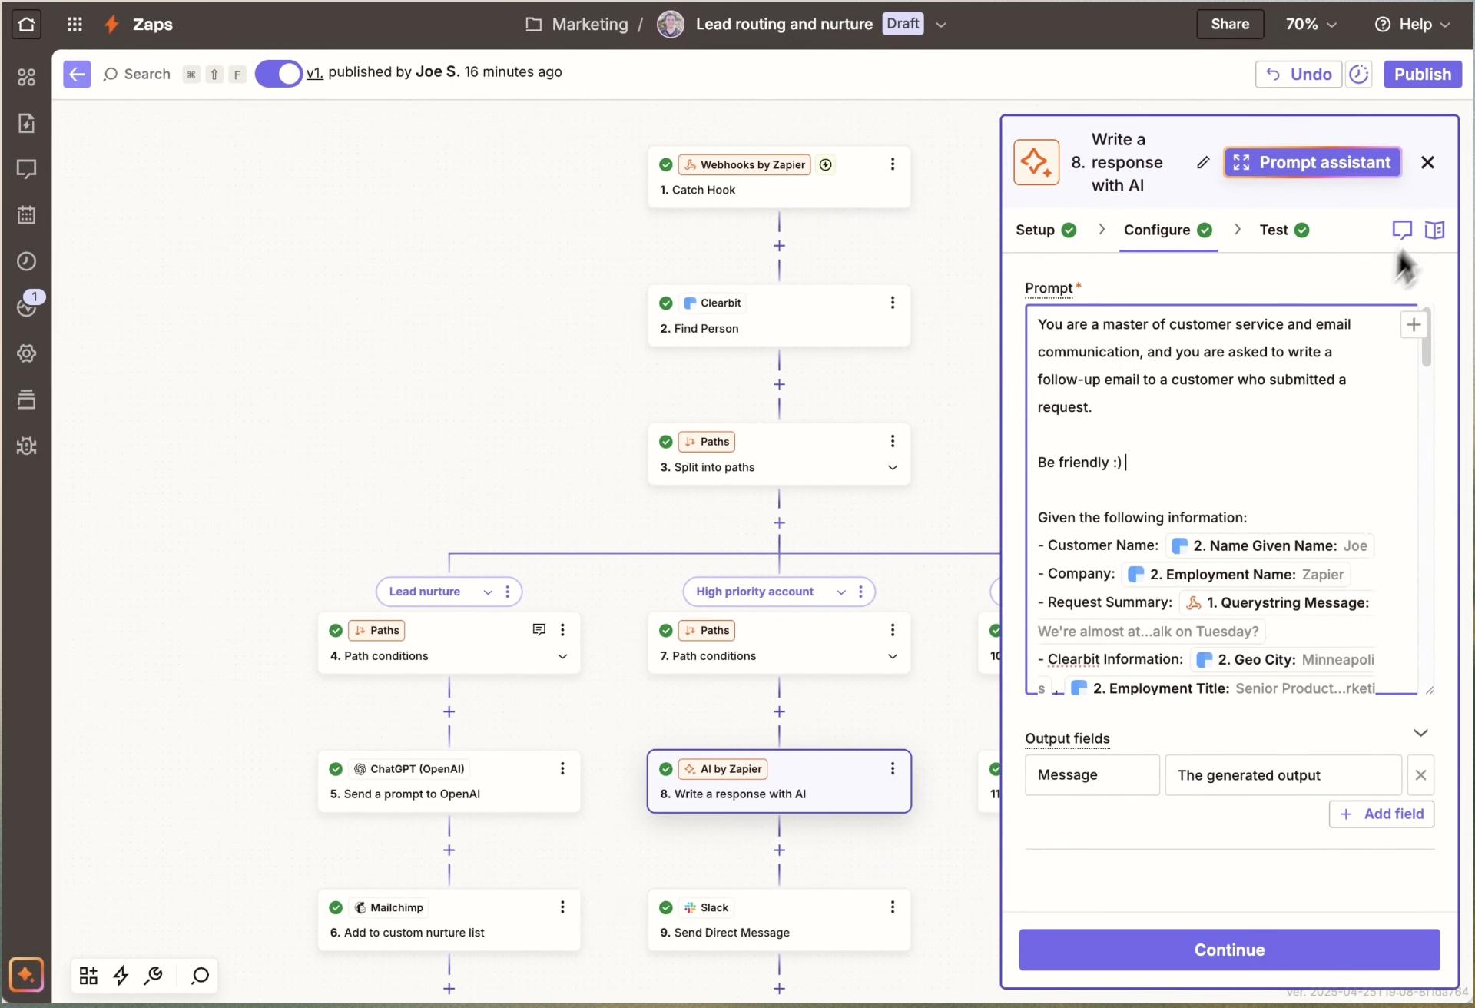
Automation Workflows
Traditional workflows, enhanced by AI (such as ChatGPT)
Generally, lots of customization and low technical bar
Tools
  Zapier
  n8n
  Microsoft PowerAutomate

Slide 26
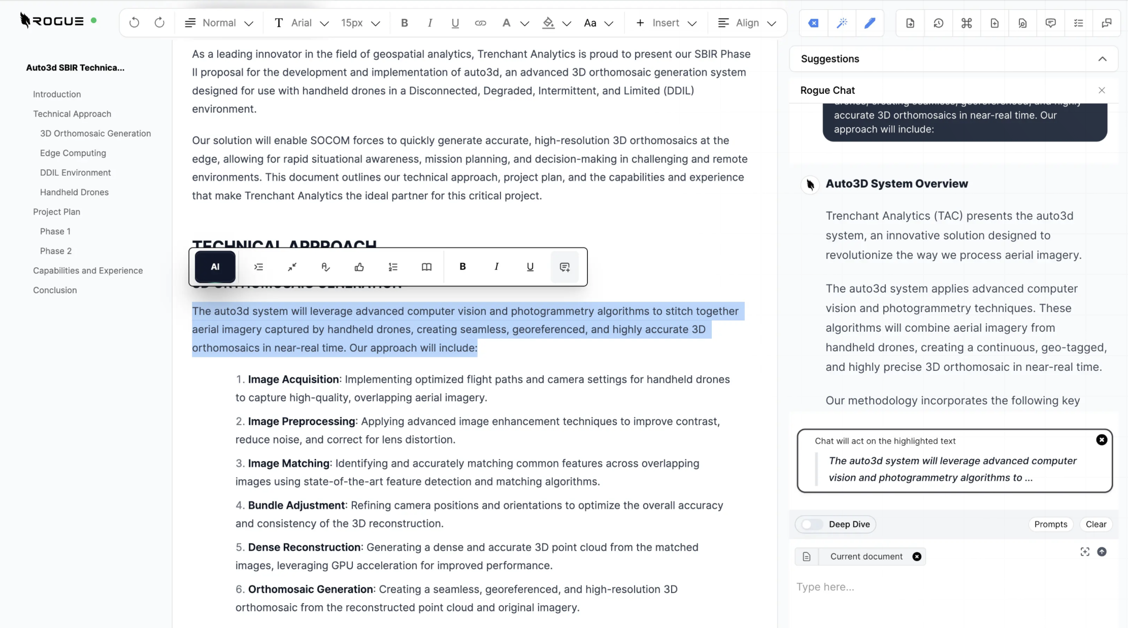
Proposal Generation
Lots of tools for proposal generation (DoD-focused and general proposals)
Tools
  GovDash
  UseRogue
  Sweetspot

Slide 27
Other General Tools
AI-Powered Email Management
  Gmail’s Smart Reply, Copilot for Outlook
AI Writing Assistants
  Grammarly, Wordtune
Task / Project Management Tools
  Asana, Notion AI
Data Analytics and Business Intelligence
  Copilot in Excel, Google Sheets “Explore”
Scheduling Assistants
AI in Customer Relation Management Tools
Speech to Text Generation
  ElevenLabs
Podcast Generation
  NotebookLM

Slide 28
Questions?
Contact Info: jackfrancis@davidson-tech.com or jackbfrancis@gmail.com

