Slide 1
Artificial Intelligence
Jack Francis
I help build and use AI to solve problems

Slide 2
Which one is real, and which one is AI?
Videos showing two dogs. Removed due to size limits

Slide 3





What is AI?
Learning to predict patterns using math, logic, and data
AI is about teaching computers to do things that normally require humans

Slide 4
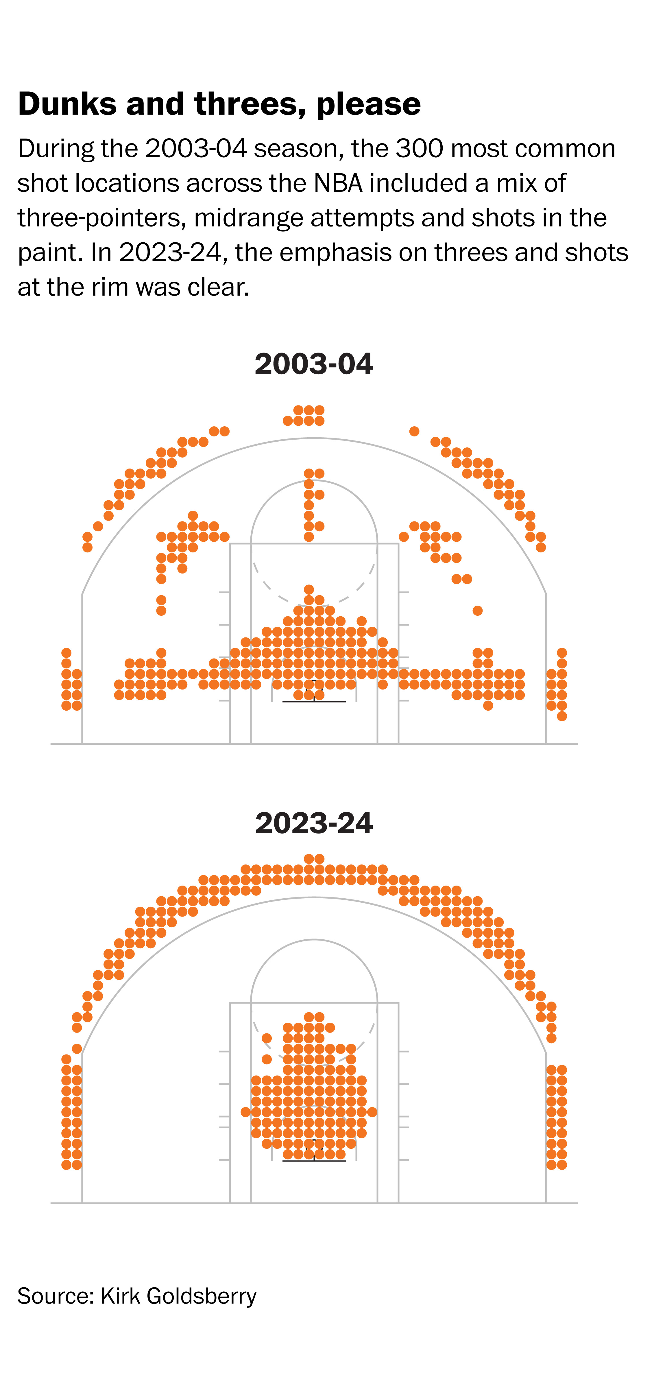
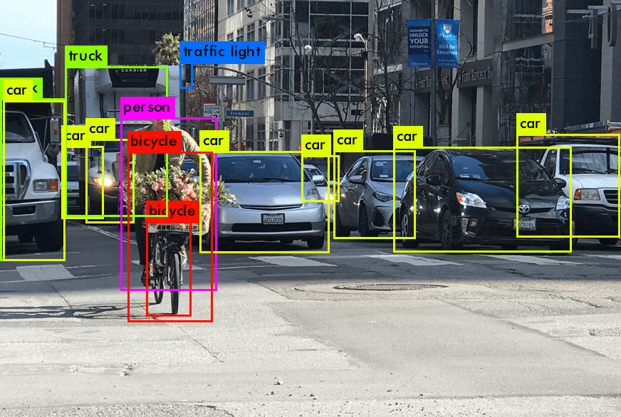
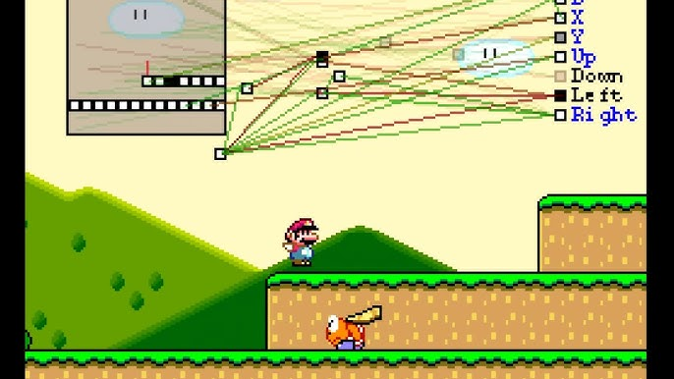
Other AI Examples

Slide 5






My Journey
Industrial Engineering
Predict Maintenance Cost
Develop AI to help warfighters
Predict How Long to Complete Orders
Build Dashboards

Slide 6
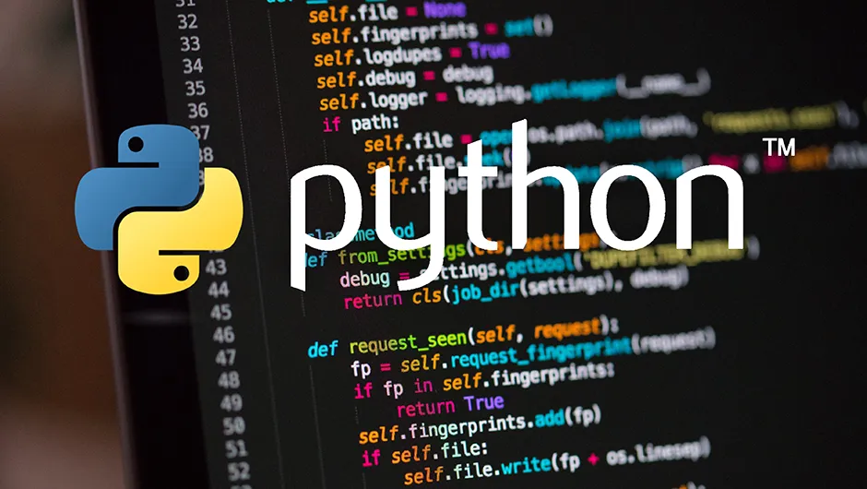
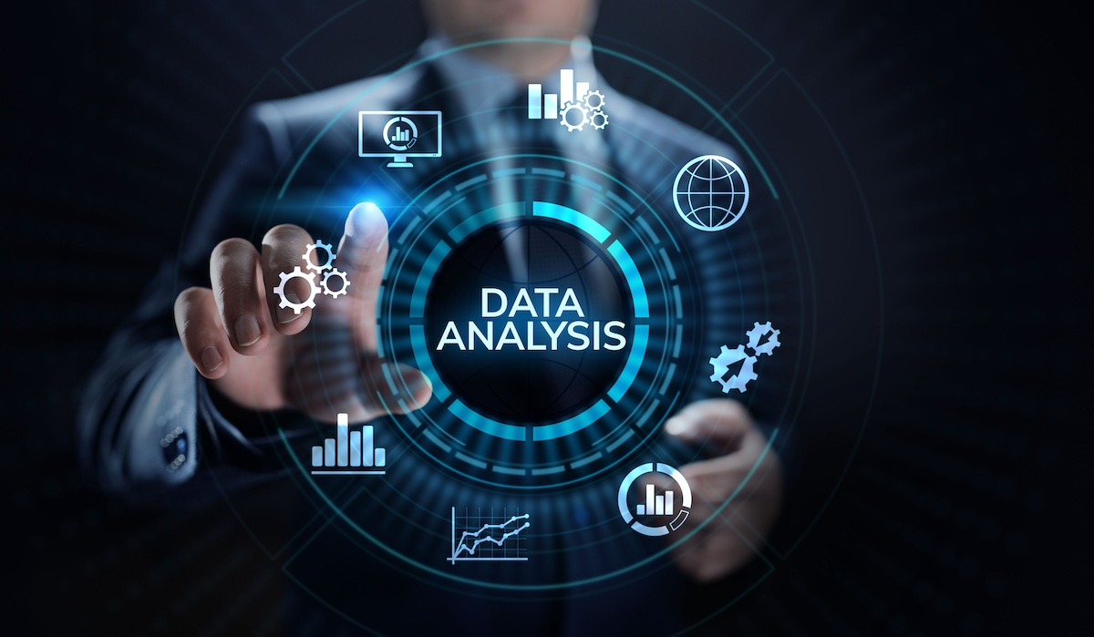
Day in the Life of an AI Developer
Data Analysis
Coding
Important skills
  Communication
  Problem Solving
  Math / Logic
  Creativity / Curiosity
Responsible AI

Slide 7
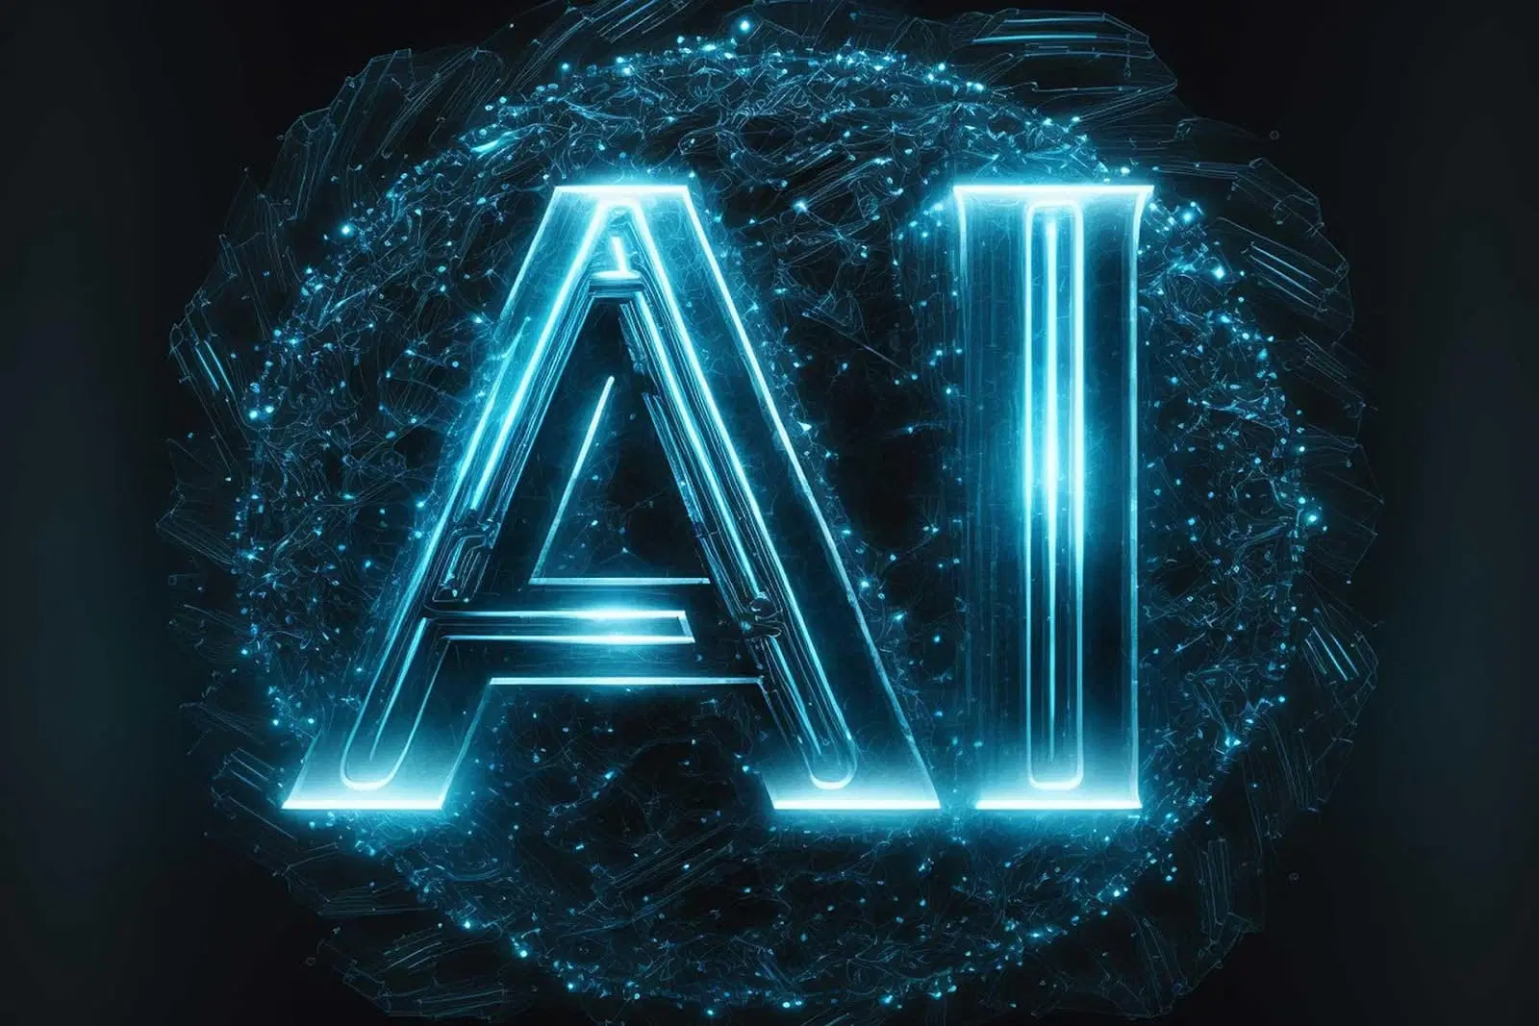
Getting into AI
Recommended Path:
  Degree in Computer Science (Coding, Math, Probability/Statistics)
  Do personal projects (Kaggle.com)
  Ask ChatGPT lots of questions
Job Roles
  Data Analyst
  Data Scientist
  AI Engineer
You can do it! STEM is a major help

