Slide 1

AI In Your Practice
September 2026
Financial and Estate Planning
01
AI In Your
Practice
Notes:
Timing: approximately 0:00–0:30
Purpose: Opens with the subject and gives the room time to settle.
Design: Bold Edit. Image and type share one composition.
Suggested language: I want to show you what these tools can do, where they fit, and then try one together.
Delivery: No agenda slide. Move directly to the introduction.
Source coverage: Financial Planning V2 slide(s) 1
[Sources]
Financial Planning V2 — /Users/jackfrancis/Documents/GitHub/Financial_Planning_AI_Talk/Financial_Planning_V2.pptx
[/Sources]
[Visual provenance]
Image cover: /Users/jackfrancis/Documents/GitHub/Financial_Planning_AI_Talk/.tmp/editorial-v3/assets/cover.png
Source: previously generated editorial cover illustration
[/Visual provenance]

Slide 2



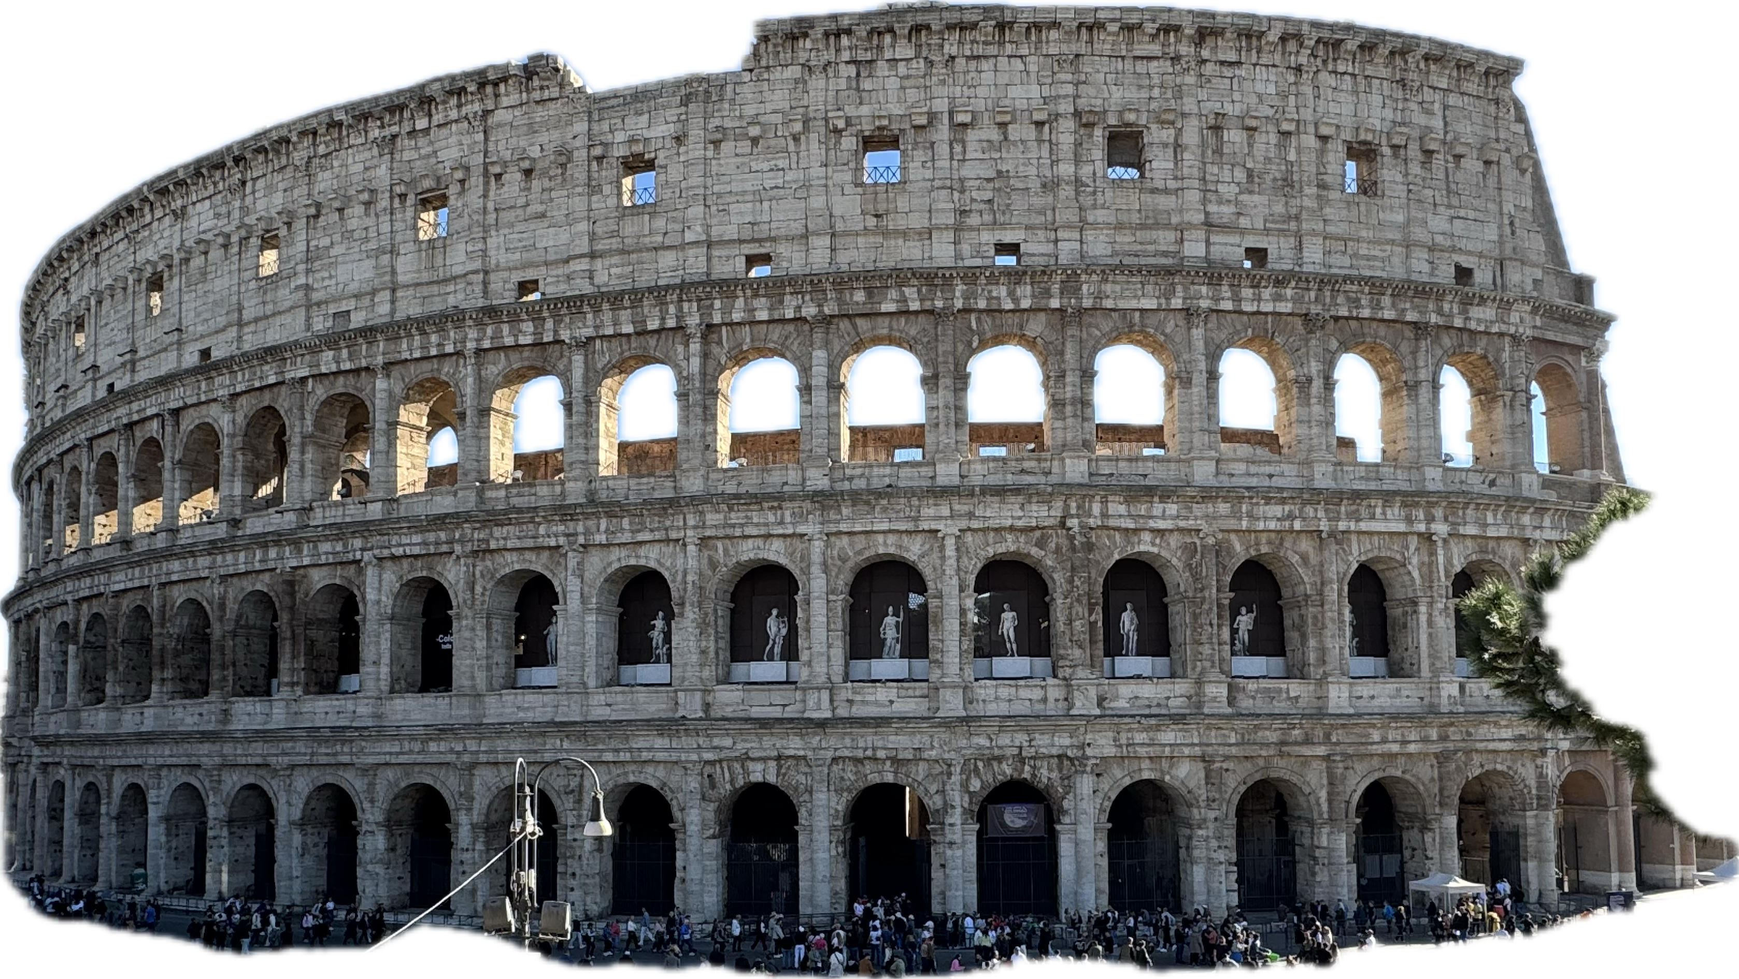

AI In Your Practice
September 2026
Financial and Estate Planning
02
Jack Francis
Blue
Ghost
Eevee
AI Solutions Director
Davidson Technologies
Rome
Tokyo
Notes:
Timing: approximately 0:30–1:30
Purpose: Keeps the personal introduction to one slide.
Design: Bold Edit. Type sets the primary read; the presenter supplies explanation.
Suggested language: My work sits between AI capability and the way people actually get work done.
Delivery: Use your own brief introduction. Role taken from the supplied BBB presentation.
Source coverage: Financial Planning V2 slide(s) 2
[Sources]
Financial Planning V2 — /Users/jackfrancis/Documents/GitHub/Financial_Planning_AI_Talk/Financial_Planning_V2.pptx
Jack Francis, BBB workshop — /Users/jackfrancis/Documents/GitHub/BBB_AI_Presentation/BBB_Practical_AI_for_Business_Leaders_Workshop_Final.pptx
[/Sources]

Slide 3

AI In Your Practice
September 2026
Financial and Estate Planning
03
AI accelerates
the process
AI does not replace the process
Notes:
Timing: approximately 1:30–3:00
Purpose: Establishes the thesis from V2. The image supports the continuing human conversation.
Design: Bold Edit. Image and type share one composition.
Suggested language: A faster draft is useful inside a process. Someone still needs to define the job, check the result, and decide what happens next.
Delivery: Use a familiar meeting preparation example. Avoid suggesting this is a replacement for professional judgment.
Source coverage: Financial Planning V2 slide(s) 3
[Sources]
Financial Planning V2 — /Users/jackfrancis/Documents/GitHub/Financial_Planning_AI_Talk/Financial_Planning_V2.pptx
[/Sources]
[Visual provenance]
Image meeting: /Users/jackfrancis/Documents/GitHub/Financial_Planning_AI_Talk/.tmp/editorial-v3/assets/meeting.png
Method: built-in image generation. Editorial illustration, not a record of an actual client or firm.
Prompt: Use case: stylized-concept. Asset: 16:9 editorial photograph for a dark conference keynote about AI in financial and estate planning. Photorealistic material study, sophisticated magazine photography, almost-black charcoal backdrop, ivory paper and a restrained deep red accent, tactile, no blue or neon, no people, no logos, no typography or legible words. All slide text will be added later. Keep image extremely dark across the left 55% so ivory text can sit there. Subject concentrated on the right half. Wide 16:9 composition. No collage, no multiple panels, no decorative AI brains or circuits. Subject: overhead architectural view of two empty charcoal upholstered chairs facing across a small round black table, positioned toward the right half of the frame. A single ivory page and a red pencil rest on the tabletop. Beautiful negative space, warm narrow pool of light only around the table, the left half entirely almost-black. Editorial metaphor for giving attention back to the client conversation, no staged handshakes, no business stock-photo people.
[/Visual provenance]

Slide 4

AI In Your Practice
September 2026
Financial and Estate Planning
04
Generative AI
Models that generate
Text
Images
Audio
Code
ChatGPT
Notes:
Timing: approximately 3:00–4:15
Purpose: Defines the category and names a familiar product.
Design: Bold Edit. Image and type share one composition.
Suggested language: Generative AI produces new content. ChatGPT is one product that gives you access to models and tools.
Delivery: ChatGPT mark supplied by OpenAI, obtained from Wikimedia Commons: https://commons.wikimedia.org/wiki/File:ChatGPT-Logo.svg . Used unchanged for product identification. No model version or subscription-specific capability claim.
Source coverage: Financial Planning V2 slide(s) 4
[Sources]
Financial Planning V2 — /Users/jackfrancis/Documents/GitHub/Financial_Planning_AI_Talk/Financial_Planning_V2.pptx
OpenAI, Use ChatGPT — https://learn.chatgpt.com/docs/use-chatgpt
[/Sources]
[Visual provenance]
Image logo: /Users/jackfrancis/Documents/GitHub/Financial_Planning_AI_Talk/.tmp/editorial-v3/assets/chatgpt-logo.png
Source: OpenAI ChatGPT mark, https://commons.wikimedia.org/wiki/File:ChatGPT-Logo.svg
[/Visual provenance]

Slide 5
AI In Your Practice
September 2026
Financial and Estate Planning
05
Four waves of AI
Chat
Content
Multimodal
Agentic
Notes:
Timing: approximately 4:15–5:00
Purpose: Introduces the four labels that organize the capability tour.
Design: Bold Edit. Type sets the primary read; the presenter supplies explanation.
Suggested language: Chat, content, multimodal, and agentic work overlap. Each adds something to what you can ask a tool to do.
Delivery: Content follows the connected-work examples in BBB: files, search, and accessible tools. These are a teaching frame, not rigid historical stages.
Source coverage: Financial Planning V2 slide(s) 5
[Sources]
Financial Planning V2 — /Users/jackfrancis/Documents/GitHub/Financial_Planning_AI_Talk/Financial_Planning_V2.pptx
Jack Francis, BBB workshop — /Users/jackfrancis/Documents/GitHub/BBB_AI_Presentation/BBB_Practical_AI_for_Business_Leaders_Workshop_Final.pptx
[/Sources]

Slide 6
AI In Your Practice
September 2026
Financial and Estate Planning
06
Chat
A request and a response
Notes:
Timing: approximately 5:00–5:20
Purpose: Introduces chat before showing the example.
Design: Bold Edit. Type sets the primary read; the presenter supplies explanation.
Suggested language: A conversation you can refine
Delivery: Keep this beat short. Advance to the visual example.
Source coverage: Financial Planning V2 slide(s) 6
[Sources]
Financial Planning V2 — /Users/jackfrancis/Documents/GitHub/Financial_Planning_AI_Talk/Financial_Planning_V2.pptx
Jack Francis, BBB workshop — /Users/jackfrancis/Documents/GitHub/BBB_AI_Presentation/BBB_Practical_AI_for_Business_Leaders_Workshop_Final.pptx
[/Sources]

Slide 7
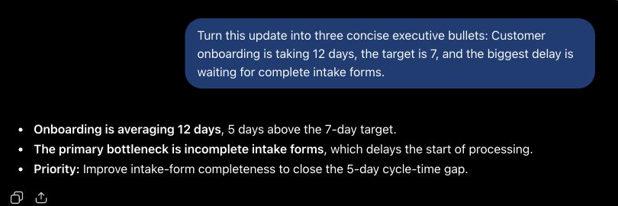
AI In Your Practice
September 2026
Financial and Estate Planning
07
A conversation you can refine
Notes:
Timing: approximately 5:20–6:25
Purpose: Uses the supplied BBB visual to show chat in a concrete product.
Design: Bold Edit. Image and type share one composition.
Suggested language: The reply is only the first pass. You can ask for a different structure or ask what it missed.
Delivery: Screenshot reproduced from BBB slide 11. It illustrates the capability, not a claim that every feature is included in a free account today.
Source coverage: Financial Planning V2 slide(s) 7
[Sources]
Financial Planning V2 — /Users/jackfrancis/Documents/GitHub/Financial_Planning_AI_Talk/Financial_Planning_V2.pptx
Jack Francis, BBB workshop — /Users/jackfrancis/Documents/GitHub/BBB_AI_Presentation/BBB_Practical_AI_for_Business_Leaders_Workshop_Final.pptx
OpenAI, Use ChatGPT — https://learn.chatgpt.com/docs/use-chatgpt
[/Sources]
[Visual provenance]
Image chat: /Users/jackfrancis/Documents/GitHub/Financial_Planning_AI_Talk/.tmp/editorial-v3/assets/image9.png
Source: user-supplied BBB presentation
[/Visual provenance]

Slide 8
AI In Your Practice
September 2026
Financial and Estate Planning
08
Content
Files and search
Notes:
Timing: approximately 6:25–6:45
Purpose: Introduces content before showing the example.
Design: Bold Edit. Type sets the primary read; the presenter supplies explanation.
Suggested language: Files and connected tools
Delivery: Keep this beat short. Advance to the visual example.
Source coverage: Financial Planning V2 slide(s) 8
[Sources]
Financial Planning V2 — /Users/jackfrancis/Documents/GitHub/Financial_Planning_AI_Talk/Financial_Planning_V2.pptx
Jack Francis, BBB workshop — /Users/jackfrancis/Documents/GitHub/BBB_AI_Presentation/BBB_Practical_AI_for_Business_Leaders_Workshop_Final.pptx
[/Sources]

Slide 9
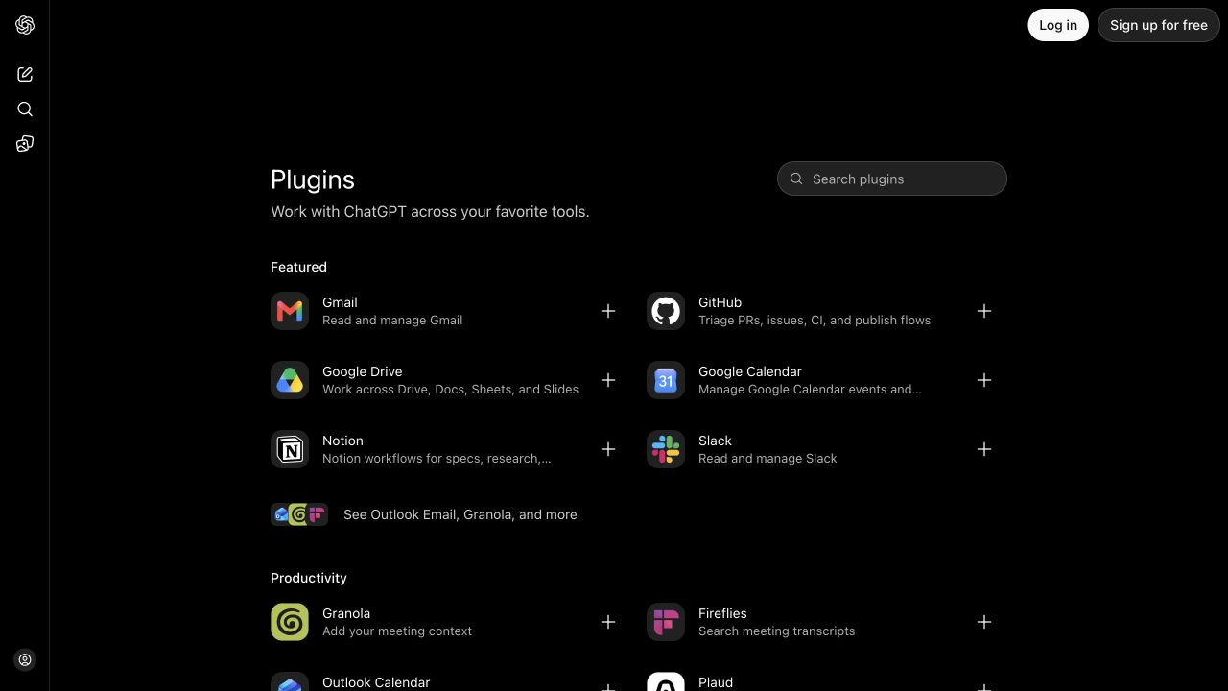
AI In Your Practice
September 2026
Financial and Estate Planning
09
Files and connected tools
Notes:
Timing: approximately 6:45–7:50
Purpose: Uses the supplied BBB visual to show content in a concrete product.
Design: Bold Edit. Image and type share one composition.
Suggested language: The tool can use material beyond the words you type, when you give it access.
Delivery: Screenshot reproduced from BBB slide 13. It illustrates the capability, not a claim that every feature is included in a free account today.
Source coverage: Financial Planning V2 slide(s) 9
[Sources]
Financial Planning V2 — /Users/jackfrancis/Documents/GitHub/Financial_Planning_AI_Talk/Financial_Planning_V2.pptx
Jack Francis, BBB workshop — /Users/jackfrancis/Documents/GitHub/BBB_AI_Presentation/BBB_Practical_AI_for_Business_Leaders_Workshop_Final.pptx
OpenAI, Use ChatGPT — https://learn.chatgpt.com/docs/use-chatgpt
[/Sources]
[Visual provenance]
Image content: /Users/jackfrancis/Documents/GitHub/Financial_Planning_AI_Talk/.tmp/editorial-v3/assets/image10.jpeg
Source: user-supplied BBB presentation
[/Visual provenance]

Slide 10
AI In Your Practice
September 2026
Financial and Estate Planning
10
Multimodal
Images, voice, and video
Notes:
Timing: approximately 7:50–8:10
Purpose: Introduces multimodal before showing the example.
Design: Bold Edit. Type sets the primary read; the presenter supplies explanation.
Suggested language: More than text
Delivery: Keep this beat short. Advance to the visual example.
Source coverage: Financial Planning V2 slide(s) 10
[Sources]
Financial Planning V2 — /Users/jackfrancis/Documents/GitHub/Financial_Planning_AI_Talk/Financial_Planning_V2.pptx
Jack Francis, BBB workshop — /Users/jackfrancis/Documents/GitHub/BBB_AI_Presentation/BBB_Practical_AI_for_Business_Leaders_Workshop_Final.pptx
[/Sources]

Slide 11
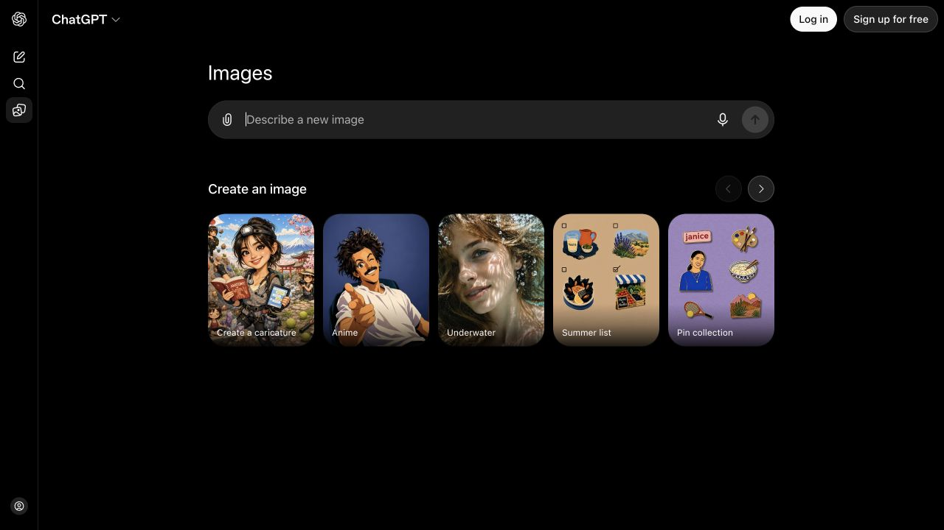
AI In Your Practice
September 2026
Financial and Estate Planning
11
More than text
Notes:
Timing: approximately 8:10–9:15
Purpose: Uses the supplied BBB visual to show multimodal in a concrete product.
Design: Bold Edit. Image and type share one composition.
Suggested language: Images are one example. Voice and other media also change how you can work with these tools.
Delivery: Screenshot reproduced from BBB slide 15. It illustrates the capability, not a claim that every feature is included in a free account today.
Source coverage: Financial Planning V2 slide(s) 11
[Sources]
Financial Planning V2 — /Users/jackfrancis/Documents/GitHub/Financial_Planning_AI_Talk/Financial_Planning_V2.pptx
Jack Francis, BBB workshop — /Users/jackfrancis/Documents/GitHub/BBB_AI_Presentation/BBB_Practical_AI_for_Business_Leaders_Workshop_Final.pptx
OpenAI, Use ChatGPT — https://learn.chatgpt.com/docs/use-chatgpt
[/Sources]
[Visual provenance]
Image multimodal: /Users/jackfrancis/Documents/GitHub/Financial_Planning_AI_Talk/.tmp/editorial-v3/assets/image11.jpeg
Source: user-supplied BBB presentation
[/Visual provenance]

Slide 12
AI In Your Practice
September 2026
Financial and Estate Planning
12
Agentic
Tools and actions
Notes:
Timing: approximately 9:15–9:35
Purpose: Introduces agentic before showing the example.
Design: Bold Edit. Type sets the primary read; the presenter supplies explanation.
Suggested language: Work toward a goal
Delivery: Keep this beat short. Advance to the visual example.
Source coverage: Financial Planning V2 slide(s) 12
[Sources]
Financial Planning V2 — /Users/jackfrancis/Documents/GitHub/Financial_Planning_AI_Talk/Financial_Planning_V2.pptx
Jack Francis, BBB workshop — /Users/jackfrancis/Documents/GitHub/BBB_AI_Presentation/BBB_Practical_AI_for_Business_Leaders_Workshop_Final.pptx
[/Sources]

Slide 13
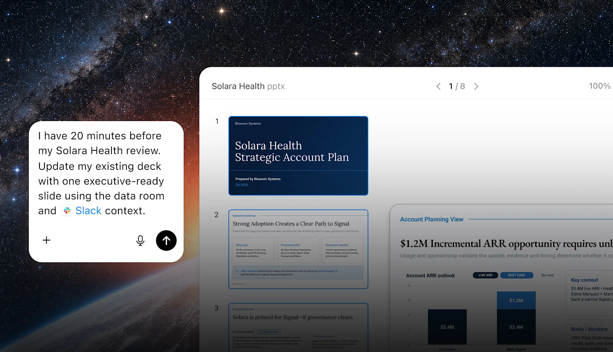
AI In Your Practice
September 2026
Financial and Estate Planning
13
Work toward a goal
Notes:
Timing: approximately 9:35–10:40
Purpose: Uses the supplied BBB visual to show agentic in a concrete product.
Design: Bold Edit. Image and type share one composition.
Suggested language: The assignment can become a task that uses context and produces a file or takes a sequence of actions.
Delivery: Screenshot reproduced from BBB slide 17. It illustrates the capability, not a claim that every feature is included in a free account today.
Source coverage: Financial Planning V2 slide(s) 13
[Sources]
Financial Planning V2 — /Users/jackfrancis/Documents/GitHub/Financial_Planning_AI_Talk/Financial_Planning_V2.pptx
Jack Francis, BBB workshop — /Users/jackfrancis/Documents/GitHub/BBB_AI_Presentation/BBB_Practical_AI_for_Business_Leaders_Workshop_Final.pptx
OpenAI, Use ChatGPT — https://learn.chatgpt.com/docs/use-chatgpt
[/Sources]
[Visual provenance]
Image agentic: /Users/jackfrancis/Documents/GitHub/Financial_Planning_AI_Talk/.tmp/editorial-v3/assets/image12.png
Source: user-supplied BBB presentation
[/Visual provenance]

Slide 14

AI In Your Practice
September 2026
Financial and Estate Planning
14
Prepare for customer meetings
Notes:
Timing: approximately 10:40–11:45
Purpose: Shows the meeting preparation example in the supplied ChatGPT Work video.
Design: Bold Edit. Image and type share one composition.
Suggested language: This example brings the task back to preparing for a customer meeting.
Delivery: Play the embedded meeting preparation video. Then advance to the computer-use example.
[Sources]
Source: user-supplied Financial Planning V3, slide 14.
Visual: ChatGPT Work video embedded in the supplied slide.
[/Sources]

Slide 15
AI In Your Practice
September 2026
Financial and Estate Planning
15
Computer use
https://x.com/ChatGPT/status/2092366556584153249
Notes:
Timing: approximately 11:45–12:50
Purpose: Introduces the linked computer-use example.
Design: The title and source link introduce an external demonstration.
Suggested language: Let’s look at the computer-use example.
Delivery: Open the link on this slide to show the example. Return to the deck for the spreadsheet example.
[Sources]
Source: user-supplied Financial Planning V3, slide 15.
Computer-use example: https://x.com/ChatGPT/status/2092366556584153249
[/Sources]

Slide 16
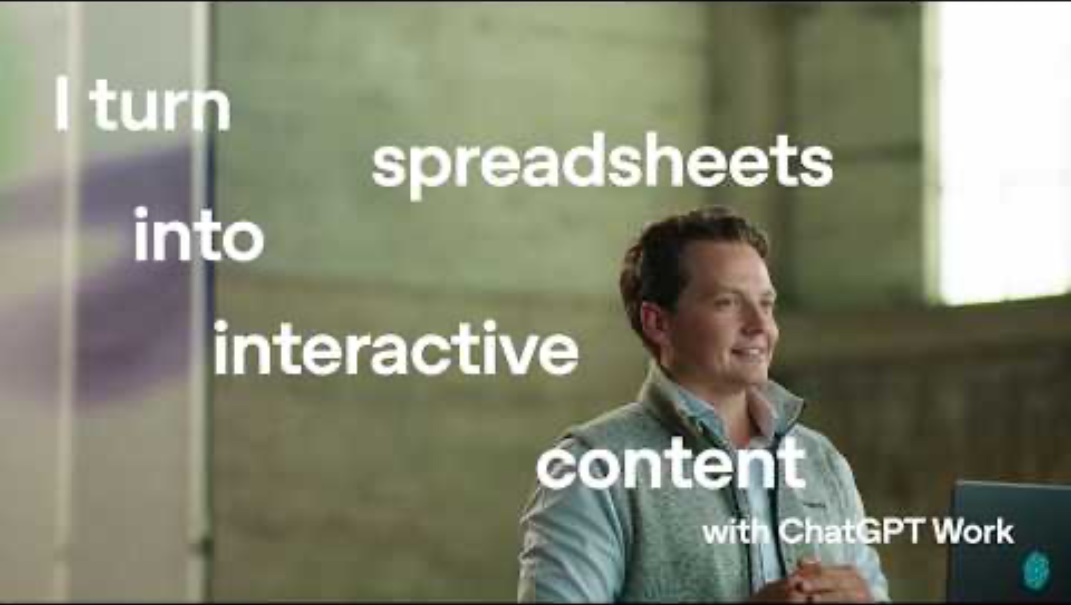
AI In Your Practice
September 2026
Financial and Estate Planning
16
Turn spreadsheet into planning tool
Notes:
Timing: approximately 12:50–13:55
Purpose: Shows the spreadsheet-to-planning-tool example in the supplied ChatGPT Work video.
Design: Bold Edit. Image and type share one composition.
Suggested language: Here the starting point is a spreadsheet, and the example shows it becoming interactive content.
Delivery: Play the embedded spreadsheet-to-planning-tool video. Then transition to the Morgan Stanley case.
[Sources]
Source: user-supplied Financial Planning V3, slide 16.
Visual: ChatGPT Work video embedded in the supplied slide.
[/Sources]

Slide 17
AI In Your Practice
September 2026
Financial and Estate Planning
17
Morgan
Stanley
Assistant
Debrief
Notes:
Timing: approximately 13:55–14:10
Purpose: Introduces two distinct tools, avoiding misattribution of the Assistant adoption statistic to Debrief.
Design: Bold Edit. Type sets the primary read; the presenter supplies explanation.
Suggested language: The Assistant helps advisors access internal knowledge. Debrief works with meeting notes and follow-up.
Delivery: The reported adoption figure belongs to Assistant, not Debrief. It is a published case-study result, not a live usage measurement.
Source coverage: Financial Planning V2 slide(s) 26, 28
[Sources]
Financial Planning V2 — /Users/jackfrancis/Documents/GitHub/Financial_Planning_AI_Talk/Financial_Planning_V2.pptx
Morgan Stanley, June 2024 — https://www.morganstanley.com/press-releases/ai-at-morgan-stanley-debrief-launch
OpenAI customer case, Morgan Stanley — https://openai.com/index/morgan-stanley/
[/Sources]

Slide 18
AI In Your Practice
September 2026
Financial and Estate Planning
18
Morgan Stanley Debrief
With client consent | Capture meeting notes
After the meeting | Summarize and identify actions
Advisor review | Edit and send the follow-up
Record | Save a note to Salesforce
Morgan Stanley, June 2024
Notes:
Timing: approximately 14:10–15:45
Purpose: Retains the complete consent, summary, review, and record workflow.
Design: Bold Edit. The native table preserves the source comparison. Type sets the primary read; the presenter supplies explanation.
Suggested language: The output becomes useful because it fits the advisor’s existing work.
Delivery: This is Morgan Stanley’s published June 2024 workflow. Keep the advisor edit-and-send step explicit. No promise of quantified time savings.
Source coverage: Financial Planning V2 slide(s) 27
[Sources]
Financial Planning V2 — /Users/jackfrancis/Documents/GitHub/Financial_Planning_AI_Talk/Financial_Planning_V2.pptx
Morgan Stanley, June 2024 — https://www.morganstanley.com/press-releases/ai-at-morgan-stanley-debrief-launch
[/Sources]

Slide 19

AI In Your Practice
September 2026
Financial and Estate Planning
19
100,000
internal documents
OpenAI customer case, Morgan Stanley
Notes:
Timing: approximately 15:45–16:30
Purpose: Gives the scale of the internal corpus its own beat.
Design: Bold Edit. Image and type share one composition.
Suggested language: That is the body of information the Assistant can work across.
Delivery: A corpus-size figure, not the number of documents an advisor reads or a measure of accuracy.
Source coverage: Financial Planning V2 slide(s) 28
[Sources]
Financial Planning V2 — /Users/jackfrancis/Documents/GitHub/Financial_Planning_AI_Talk/Financial_Planning_V2.pptx
OpenAI customer case, Morgan Stanley — https://openai.com/index/morgan-stanley/
[/Sources]
[Visual provenance]
Image archive: /Users/jackfrancis/Documents/GitHub/Financial_Planning_AI_Talk/.tmp/editorial-v3/assets/archive.png
Method: built-in image generation. Editorial illustration, not a record of an actual client or firm.
Prompt: Use case: stylized-concept. Asset: 16:9 editorial photograph for a dark conference keynote about AI in financial and estate planning. Photorealistic material study, sophisticated magazine photography, almost-black charcoal backdrop, ivory paper and a restrained deep red accent, tactile, no blue or neon, no people, no logos, no typography or legible words. All slide text will be added later. Keep image extremely dark across the left 55% so ivory text can sit there. Subject concentrated on the right half. Wide 16:9 composition. No collage, no multiple panels, no decorative AI brains or circuits. Subject: a fan of archival paper folders, their thin edges staggered in a shallow diagonal, with a single red index tab. Side light catches the paper edges. The sense is a large body of knowledge becoming accessible, not a pile of clutter. Fine grain, controlled shadows. The far right has physical paper depth, the entire left side fades into charcoal.
[/Visual provenance]

Slide 20
AI In Your Practice
September 2026
Financial and Estate Planning
20
Over 98%
of advisor teams use the Assistant
OpenAI customer case, Morgan Stanley
Notes:
Timing: approximately 16:30–17:15
Purpose: Gives the adoption result a distinct, clearly labeled beat.
Design: Bold Edit. Type sets the primary read; the presenter supplies explanation.
Suggested language: The interesting part is whether the tool becomes part of daily work.
Delivery: This is the Assistant adoption figure reported in the customer case, not a Debrief figure.
Source coverage: Financial Planning V2 slide(s) 28
[Sources]
Financial Planning V2 — /Users/jackfrancis/Documents/GitHub/Financial_Planning_AI_Talk/Financial_Planning_V2.pptx
OpenAI customer case, Morgan Stanley — https://openai.com/index/morgan-stanley/
[/Sources]

Slide 21
AI In Your Practice
September 2026
Financial and Estate Planning
21
AI @ Morgan Stanley Assistant
OpenAI customer case, Morgan Stanley
Notes:
Timing: approximately 17:15–18:45
Purpose: Distinguishes document access, corpus size and adoption rather than labeling all three as retrieval accuracy.
Design: Bold Edit. The native chart uses a zero baseline and directly labeled source values. Type sets the primary read; the presenter supplies explanation.
Suggested language: The case reports wider document access and less time searching, across a large internal collection.
Delivery: The primary case says access to documents moved from 20% to 80%. It does not define this as accuracy, elapsed-time reduction, or a 60% productivity gain. The 100,000 figure is corpus size. Reported benefits include more attention for client relationships.
Source coverage: Financial Planning V2 slide(s) 28
[Sources]
Financial Planning V2 — /Users/jackfrancis/Documents/GitHub/Financial_Planning_AI_Talk/Financial_Planning_V2.pptx
OpenAI customer case, Morgan Stanley — https://openai.com/index/morgan-stanley/
[/Sources]

Slide 22
AI In Your Practice
September 2026
Financial and Estate Planning
22
More time for
the conversation
OpenAI customer case, Morgan Stanley
Notes:
Timing: approximately 18:45–19:55
Purpose: Resolves the opening thesis through the client relationship benefit in V2.
Design: Bold Edit. Image and type share one composition.
Suggested language: The process is still theirs. Less searching and less administration can leave more time for the client.
Delivery: Pause on the client relationship benefit, then transition to the data protection section.
Source coverage: Financial Planning V2 slide(s) 28
[Sources]
Financial Planning V2 — /Users/jackfrancis/Documents/GitHub/Financial_Planning_AI_Talk/Financial_Planning_V2.pptx
OpenAI customer case, Morgan Stanley — https://openai.com/index/morgan-stanley/
[/Sources]
[Visual provenance]
Image meeting: /Users/jackfrancis/Documents/GitHub/Financial_Planning_AI_Talk/.tmp/editorial-v3/assets/meeting.png
Method: built-in image generation. Editorial illustration, not a record of an actual client or firm.
Prompt: Use case: stylized-concept. Asset: 16:9 editorial photograph for a dark conference keynote about AI in financial and estate planning. Photorealistic material study, sophisticated magazine photography, almost-black charcoal backdrop, ivory paper and a restrained deep red accent, tactile, no blue or neon, no people, no logos, no typography or legible words. All slide text will be added later. Keep image extremely dark across the left 55% so ivory text can sit there. Subject concentrated on the right half. Wide 16:9 composition. No collage, no multiple panels, no decorative AI brains or circuits. Subject: overhead architectural view of two empty charcoal upholstered chairs facing across a small round black table, positioned toward the right half of the frame. A single ivory page and a red pencil rest on the tabletop. Beautiful negative space, warm narrow pool of light only around the table, the left half entirely almost-black. Editorial metaphor for giving attention back to the client conversation, no staged handshakes, no business stock-photo people.
[/Visual provenance]

Slide 23

AI In Your Practice
September 2026
Financial and Estate Planning
23
Data
protection
Notes:
Timing: approximately 19:55–20:20
Purpose: Introduces data
protection through a relevant material or setting.
Design: Bold Edit. Image and type share one composition.
Suggested language: The next question is what happens to the information you provide.
Delivery: Use this as a brief transition. The image is an editorial illustration, not evidence.
Source coverage: Financial Planning V2 slide(s) section transition
[Sources]
Financial Planning V2 — /Users/jackfrancis/Documents/GitHub/Financial_Planning_AI_Talk/Financial_Planning_V2.pptx
[/Sources]
[Visual provenance]
Image privacy: /Users/jackfrancis/Documents/GitHub/Financial_Planning_AI_Talk/.tmp/editorial-v3/assets/privacy.png
Method: built-in image generation. Editorial illustration, not a record of an actual client or firm.
Prompt: Use case: stylized-concept. Asset: 16:9 editorial photograph for a dark conference keynote about AI in financial and estate planning. Photorealistic material study, sophisticated magazine photography, almost-black charcoal backdrop, ivory paper and a restrained deep red accent, tactile, no blue or neon, no people, no logos, no typography or legible words. All slide text will be added later. Keep image extremely dark across the left 55% so ivory text can sit there. Subject concentrated on the right half. Wide 16:9 composition. No collage, no multiple panels, no decorative AI brains or circuits. Subject: a thick fluted glass pane standing on a dark desk in front of a folded ivory document on the right. The glass obscures the paper beneath it. A narrow deep-red paper edge is visible just outside the glass. Quiet optical distortion and reflected edge light. Suggest information boundaries and visibility without locks, shields, chains, warning signs, or cyber-security stock imagery.
[/Visual provenance]

Slide 24
AI In Your Practice
September 2026
Financial and Estate Planning
24
Where does the data go?
Training | Do prompts and files improve the model?
Retention | How long does the provider keep them?
Location | Where does it store and process data?
FINRA Regulatory Notice 24-09
Notes:
Timing: approximately 20:20–21:45
Purpose: Separates the source privacy questions while preserving every entry.
Design: Bold Edit. The native table preserves the source comparison. Type sets the primary read; the presenter supplies explanation.
Suggested language: Data residency is one part of the question. Training, retention, access, connected services, and control also matter.
Delivery: Use the location row to distinguish storage from processing. The source is a question list for due diligence, not a universal compliance determination.
Source coverage: Financial Planning V2 slide(s) 24
[Sources]
Financial Planning V2 — /Users/jackfrancis/Documents/GitHub/Financial_Planning_AI_Talk/Financial_Planning_V2.pptx
FINRA Regulatory Notice 24-09 — https://www.finra.org/rules-guidance/notices/24-09
CFP Board AI Ethics Guide — https://www.cfp.net/news/2025/02/news-releases/guide-on-ethical-use-of-generative-ai
[/Sources]

Slide 25
AI In Your Practice
September 2026
Financial and Estate Planning
25
Where does the data go?
Access | Who can see prompts, files, and outputs?
Other tools | Which connected services receive data?
Control | Can the firm audit use and delete data?
FINRA Regulatory Notice 24-09
Notes:
Timing: approximately 21:45–23:10
Purpose: Separates the source privacy questions while preserving every entry.
Design: Bold Edit. The native table preserves the source comparison. Type sets the primary read; the presenter supplies explanation.
Suggested language: Data residency is one part of the question. Training, retention, access, connected services, and control also matter.
Delivery: Walk through access, connected services, and firm control. These complete the questions introduced on the previous slide.
Source coverage: Financial Planning V2 slide(s) 24
[Sources]
Financial Planning V2 — /Users/jackfrancis/Documents/GitHub/Financial_Planning_AI_Talk/Financial_Planning_V2.pptx
FINRA Regulatory Notice 24-09 — https://www.finra.org/rules-guidance/notices/24-09
CFP Board AI Ethics Guide — https://www.cfp.net/news/2025/02/news-releases/guide-on-ethical-use-of-generative-ai
[/Sources]

Slide 26
AI In Your Practice
September 2026
Financial and Estate Planning
26
Personal and work accounts
Personal account | Training and history settings
Approved work account | Firm controls and permitted uses
Client information needs an approved workflow.
FINRA Regulatory Notice 24-09
Notes:
Timing: approximately 23:10–24:55
Purpose: Preserves the distinction between a personal setting and an approved firm workflow.
Design: Bold Edit. The native table preserves the source comparison. Type sets the primary read; the presenter supplies explanation.
Suggested language: A personal privacy setting and a firm-approved use are different questions.
Delivery: Keep this to the account and provider distinction. Do not promise zero retention or a specific storage country for a personal account. Current provider terms and firm requirements govern.
Source coverage: Financial Planning V2 slide(s) 25
[Sources]
Financial Planning V2 — /Users/jackfrancis/Documents/GitHub/Financial_Planning_AI_Talk/Financial_Planning_V2.pptx
FINRA Regulatory Notice 24-09 — https://www.finra.org/rules-guidance/notices/24-09
ChatGPT data controls — https://help.openai.com/en/articles/7730893-data-controls-faq
Temporary Chat — https://help.openai.com/en/articles/8914046-temporary-chat-faq
[/Sources]

Slide 27

AI In Your Practice
September 2026
Financial and Estate Planning
27
Prompting
Notes:
Timing: approximately 24:55–25:15
Purpose: Introduces prompting through a relevant material or setting.
Design: Bold Edit. Image and type share one composition.
Suggested language: Let’s look at the assignment itself.
Delivery: Use this as a brief transition. The image is an editorial illustration, not evidence.
Source coverage: Financial Planning V2 slide(s) section transition
[Sources]
Financial Planning V2 — /Users/jackfrancis/Documents/GitHub/Financial_Planning_AI_Talk/Financial_Planning_V2.pptx
[/Sources]
[Visual provenance]
Image review: /Users/jackfrancis/Documents/GitHub/Financial_Planning_AI_Talk/.tmp/editorial-v3/assets/review.png
Method: built-in image generation. Editorial illustration, not a record of an actual client or firm.
Prompt: Use case: stylized-concept. Asset: 16:9 editorial photograph for a dark conference keynote about AI in financial and estate planning. Photorealistic material study, sophisticated magazine photography, almost-black charcoal backdrop, ivory paper and a restrained deep red accent, tactile, no blue or neon, no people, no logos, no typography or legible words. All slide text will be added later. Keep image extremely dark across the left 55% so ivory text can sit there. Subject concentrated on the right half. Wide 16:9 composition. No collage, no multiple panels, no decorative AI brains or circuits. Subject: extreme close-up of a single sheet of ivory paper curling upward from a dark graphite desk, with a sharpened red pencil resting diagonally on the lower right margin. A few dark graphite handwritten editing marks are out of focus and entirely illegible. Light rakes across the paper tooth. Focus on the point of the pencil meeting the page. Distinct from a stack of blank pages: one working page, intimate macro detail, purposeful physical review.
[/Visual provenance]

Slide 28
AI In Your Practice
September 2026
Financial and Estate Planning
28
“Summarize
these notes.”
Notes:
Timing: approximately 25:15–26:15
Purpose: Shows the deliberately generic prompt that will be improved.
Design: Bold Edit. Image and type share one composition.
Suggested language: A summary may be fine. But it does not tell the model what we need to do with the notes.
Delivery: Ask the audience what useful information is missing from the assignment.
Source coverage: Financial Planning V2 slide(s) 17
[Sources]
Financial Planning V2 — /Users/jackfrancis/Documents/GitHub/Financial_Planning_AI_Talk/Financial_Planning_V2.pptx
[/Sources]
[Visual provenance]
Image review: /Users/jackfrancis/Documents/GitHub/Financial_Planning_AI_Talk/.tmp/editorial-v3/assets/review.png
Method: built-in image generation. Editorial illustration, not a record of an actual client or firm.
Prompt: Use case: stylized-concept. Asset: 16:9 editorial photograph for a dark conference keynote about AI in financial and estate planning. Photorealistic material study, sophisticated magazine photography, almost-black charcoal backdrop, ivory paper and a restrained deep red accent, tactile, no blue or neon, no people, no logos, no typography or legible words. All slide text will be added later. Keep image extremely dark across the left 55% so ivory text can sit there. Subject concentrated on the right half. Wide 16:9 composition. No collage, no multiple panels, no decorative AI brains or circuits. Subject: extreme close-up of a single sheet of ivory paper curling upward from a dark graphite desk, with a sharpened red pencil resting diagonally on the lower right margin. A few dark graphite handwritten editing marks are out of focus and entirely illegible. Light rakes across the paper tooth. Focus on the point of the pencil meeting the page. Distinct from a stack of blank pages: one working page, intimate macro detail, purposeful physical review.
[/Visual provenance]

Slide 29
AI In Your Practice
September 2026
Financial and Estate Planning
29
A useful prompt
Persona | Who should it act as?
Context | What does it need to know?
Task | What should it do?
Constraint | What should it avoid?
Format | How should it return the answer?
Notes:
Timing: approximately 26:15–27:55
Purpose: Preserves all five prompting questions in the source table.
Design: Bold Edit. The native table preserves the source comparison. Type sets the primary read; the presenter supplies explanation.
Suggested language: This is the same information you would give a colleague when assigning work.
Delivery: Walk through the parts once. A persona helps frame the task; it does not grant expertise.
Source coverage: Financial Planning V2 slide(s) 15
[Sources]
Financial Planning V2 — /Users/jackfrancis/Documents/GitHub/Financial_Planning_AI_Talk/Financial_Planning_V2.pptx
Jack Francis, BBB workshop — /Users/jackfrancis/Documents/GitHub/BBB_AI_Presentation/BBB_Practical_AI_for_Business_Leaders_Workshop_Final.pptx
[/Sources]

Slide 30
AI In Your Practice
September 2026
Financial and Estate Planning
29
A useful prompt
Persona | Meeting assistant
Context | These notes only
Task | Actions and questions for the next meeting
Constraint | Leave missing facts open
Format | Under 150 words
Notes:
Timing: approximately 26:15–27:55
Purpose: Preserves all five prompting questions in the source table.
Design: Bold Edit. The native table preserves the source comparison. Type sets the primary read; the presenter supplies explanation.
Suggested language: This is the same information you would give a colleague when assigning work.
Delivery: Walk through the parts once. A persona helps frame the task; it does not grant expertise.
Source coverage: Financial Planning V2 slide(s) 15
[Sources]
Financial Planning V2 — /Users/jackfrancis/Documents/GitHub/Financial_Planning_AI_Talk/Financial_Planning_V2.pptx
Jack Francis, BBB workshop — /Users/jackfrancis/Documents/GitHub/BBB_AI_Presentation/BBB_Practical_AI_for_Business_Leaders_Workshop_Final.pptx
[/Sources]

Slide 31
AI In Your Practice
September 2026
Financial and Estate Planning
31
What is missing?
“What would you need
to know first?”
Ask me three questions and wait.
Notes:
Timing: approximately 30:15–31:55
Purpose: Adds a clarification turn rather than requiring the perfect first prompt.
Design: Bold Edit. Type sets the primary read; the presenter supplies explanation.
Suggested language: The model can help uncover missing context. You can also decide to leave a question unanswered.
Delivery: This is a complete usable follow-up. Distinguish useful questions from invented facts.
Source coverage: Financial Planning V2 slide(s) 19
[Sources]
Financial Planning V2 — /Users/jackfrancis/Documents/GitHub/Financial_Planning_AI_Talk/Financial_Planning_V2.pptx
[/Sources]

Slide 32
AI In Your Practice
September 2026
Financial and Estate Planning
32
What changed?
What became more useful?
What still needs checking?
Where would this help in your work?
Notes:
Timing: approximately 31:55–38:55 (discussion and Q&A)
Purpose: Closes with reflection on the prompting examples and the attendee’s own use case.
Design: Bold Edit. Type sets the primary read; the presenter supplies explanation.
Suggested language: What would you keep from the revised answer?
Delivery: Allow seven minutes for discussion and Q&A. Invite observations about what became more useful and what still needs checking. Open the appendix only if a question calls for it.
Source coverage: Financial Planning V2 slide(s) 33
[Sources]
Financial Planning V2 — /Users/jackfrancis/Documents/GitHub/Financial_Planning_AI_Talk/Financial_Planning_V2.pptx
[/Sources]

Slide 33
AI In Your Practice
September 2026
Financial and Estate Planning
33
Questions?
Download the slides: jfprojects.dev
Email: jackbfrancis@gmail.com, jack.francis@aihuntsville.org
If you’re interested in the AI Use Policy developed by AI Huntsville, please email me!
Notes:
Timing: approximately 31:55–38:55 (discussion and Q&A)
Purpose: Closes with reflection on the prompting examples and the attendee’s own use case.
Design: Bold Edit. Type sets the primary read; the presenter supplies explanation.
Suggested language: What would you keep from the revised answer?
Delivery: Allow seven minutes for discussion and Q&A. Invite observations about what became more useful and what still needs checking. Open the appendix only if a question calls for it.
Source coverage: Financial Planning V2 slide(s) 33
[Sources]
Financial Planning V2 — /Users/jackfrancis/Documents/GitHub/Financial_Planning_AI_Talk/Financial_Planning_V2.pptx
[/Sources]

Slide 34
AI In Your Practice
September 2026
Financial and Estate Planning
34
Questions for your firm
Training | Does the provider use customer data to train?
Retention | What are the retention and deletion terms?
Location | Where does it store and process data?
Access | Who can see prompts, files, and outputs?
FINRA Regulatory Notice 24-09
Notes:
Timing: Reference
Purpose: Presents the first four provider and firm questions for reference.
Design: Bold Edit. The native table preserves the source comparison. Type sets the primary read; the presenter supplies explanation.
Suggested language: These are useful questions to take back to your organization.
Delivery: Untimed reference. The next slide completes the list.
Source coverage: Financial Planning V2 slide(s) 34
[Sources]
Financial Planning V2 — /Users/jackfrancis/Documents/GitHub/Financial_Planning_AI_Talk/Financial_Planning_V2.pptx
FINRA Regulatory Notice 24-09 — https://www.finra.org/rules-guidance/notices/24-09
CFP Board AI Ethics Guide — https://www.cfp.net/news/2025/02/news-releases/guide-on-ethical-use-of-generative-ai
[/Sources]

Slide 35
AI In Your Practice
September 2026
Financial and Estate Planning
35
Questions for your firm
Connections | Which services receive data?
Audit | Can the firm audit use and enforce controls?
Review | What human review does the work require?
Approval | Which tools and uses has the firm approved?
FINRA Regulatory Notice 24-09
Notes:
Timing: Reference
Purpose: Completes the provider and firm questions for reference.
Design: Bold Edit. The native table preserves the source comparison. Type sets the primary read; the presenter supplies explanation.
Suggested language: These are useful questions to take back to your organization.
Delivery: Untimed reference. Continue from the previous slide with connections, audit, review, and approval.
Source coverage: Financial Planning V2 slide(s) 34
[Sources]
Financial Planning V2 — /Users/jackfrancis/Documents/GitHub/Financial_Planning_AI_Talk/Financial_Planning_V2.pptx
FINRA Regulatory Notice 24-09 — https://www.finra.org/rules-guidance/notices/24-09
CFP Board AI Ethics Guide — https://www.cfp.net/news/2025/02/news-releases/guide-on-ethical-use-of-generative-ai
[/Sources]

Slide 36
AI In Your Practice
September 2026
Financial and Estate Planning
36
Sources
Morgan Stanley Debrief
Morgan Stanley customer case
CFP Board AI Ethics Guide
CFP Board beginner’s guide
FINRA Regulatory Notice 24-09
ChatGPT access and plans
ChatGPT data controls
Temporary Chat
Notes:
Timing: Reference
Purpose: Keeps source links available without adding a reading list to the talk.
Design: Bold Edit. Type sets the primary read; the presenter supplies explanation.
Suggested language: The source titles are clickable.
Delivery: Untimed reference. Product access reviewed September 8, 2026. The source screenshots are from Jack’s BBB deck and may depict features outside the free plan.
Source coverage: Financial Planning V2 slide(s) 35
[Sources]
Financial Planning V2 — /Users/jackfrancis/Documents/GitHub/Financial_Planning_AI_Talk/Financial_Planning_V2.pptx
Morgan Stanley, June 2024 — https://www.morganstanley.com/press-releases/ai-at-morgan-stanley-debrief-launch
OpenAI customer case, Morgan Stanley — https://openai.com/index/morgan-stanley/
CFP Board AI Ethics Guide — https://www.cfp.net/news/2025/02/news-releases/guide-on-ethical-use-of-generative-ai
CFP Board, 2026 — https://www.cfp.net/industry-insights/2026/08/a-beginners-guide-to-integrating-ai-into-your-financial-practice
FINRA Regulatory Notice 24-09 — https://www.finra.org/rules-guidance/notices/24-09
ChatGPT access and plans — https://learn.chatgpt.com/docs/pricing
ChatGPT data controls — https://help.openai.com/en/articles/7730893-data-controls-faq
Temporary Chat — https://help.openai.com/en/articles/8914046-temporary-chat-faq
Jack Francis, BBB workshop — /Users/jackfrancis/Documents/GitHub/BBB_AI_Presentation/BBB_Practical_AI_for_Business_Leaders_Workshop_Final.pptx
OpenAI, Use ChatGPT — https://learn.chatgpt.com/docs/use-chatgpt
OpenAI, Agents SDK — https://developers.openai.com/api/docs/guides/agents-sdk
[/Sources]

