Slide 1
How Artificial Intelligence is Transforming National Security
Dr. Jack Francis, AI Solutions Director, Davidson Technologies Jason Kearns, Principal Enterprise Architect, Davidson Technologies

Slide 2
Agenda
Traditional AI vs Generative AI
AI for Decision Advantage
AI-Enhanced Adversarial Capabilities
Conclusion
2

Slide 3




AI isn’t new, but GenAI is
Traditional AI: Analyze existing data to make predictions
ISR: Computer vision for automated target recognition (Project Maven)
Command and Control: Fuse sensor data into common operating picture (CJADC2)
Predictive Maintenance: Increasing equipment readiness (PANDA, CBM+)
Generative AI: Create new, original content
Large Language Model (LLM): The core engine behind most GenAI today
Agentic AI: AI that can autonomously plan, reason, and execute complex tasks to achieve a goal, rather than just following a list of human-given commands.
Task Force Lima: 2023-24 CDAO Task Force to evaluate GenAI within DoD
GSA Centralized Procurement: LLM Access for $1 per agency (ChatGPT, Gemini)
GenAI.mil: LLM Access to top models for DoD
AI Action Plan: Significant focus on GenAI (LLM training, evaluation, infrastructure) [1]
[1] https://www.ai.gov/action-plan
3

Slide 4
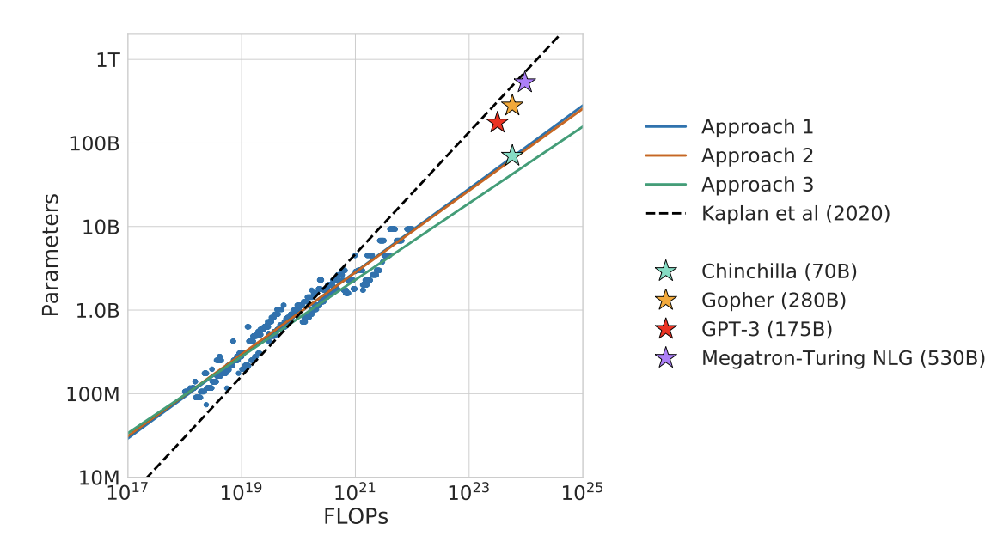
Compute-to-Capability Pipeline
LLM’s are built on the transformer architecture
Ideal architecture for GPU training
More data + more parameters + more compute = better LLM (power law relationship)
The Compute-to-Capability Pipeline: More compute directly leads to more capable LLMs. LLM scaling laws have guided top research organizations.
A nation's ability to develop, train, and deploy the largest AI models is now a direct measure of its potential power on the global stage.
LLM Scaling Laws [1]. Demonstrating relationship between number of parameters and compute
[1] https://arxiv.org/abs/2203.15556
4

Slide 5
US vs China AI Philosophy
U.S. Strategy: Market-Led
Our most powerful models (GPT-5.3, Gemini 3.1, Claude Opus 4.6) are incredibly capable, proprietary, and controlled by a few key industry partners.
AI Action Plan and Executive Orders
China Strategy: State-Led
Military Civil Fusion -> Dual-use by design. AI Global Governance Action Plan
15-30% of LLM usage today is with Chinese open-source models
Top open-weight models are globally available, easily modified, and can be weaponized by anyone from peer adversaries to non-state actors.
Implication for National Security: We must be prepared to face adversaries using highly customized, unpredictable open-weight models that are not in our threat libraries and can evolve outside our visibility.
5

Slide 6
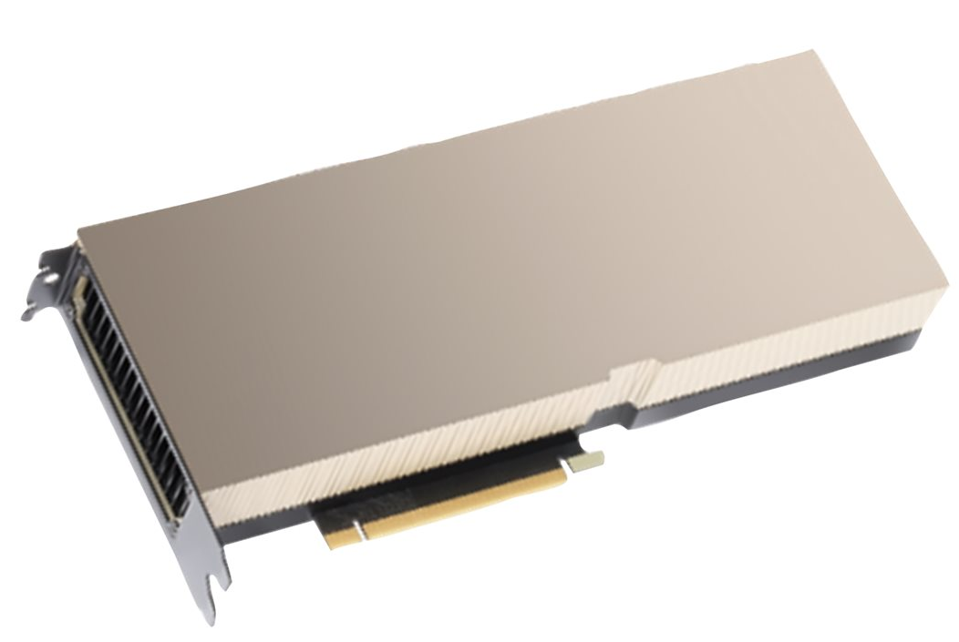
New Era of Power – Importance of Compute
Training state-of-the-art models requires data centers at an unprecedented scale
OpenAI estimated to spend ~$12B in 2024 for training / inference [1]
xAI plans to expand Colossus to 1 million GPUs [2]
Nvidia shipped 3.76M data center GPUs in 2023 [2]
Why does this matter? -> More compute leads to better models, with higher-quality outputs
Improved Decision Making to achieve Decision Advantage
Improved adversarial capabilities for cyber attacks
Nvidia H100
[1] https://www.arcade.dev/blog/ai-inference-economics
[2] https://www.datacenterdynamics.com/en/news/xai-elon-musk-memphis-colossus-gpu/
6

Slide 7
Decision Advantage
The product of situational understanding, the ability to assure and exchange information, make and communicate decisions by maintaining advantages in all domains. [AFDP 3-99]
Battlespace awareness and understanding
Adaptive force planning and application
Fast, precise, and resilient kill chains
Resilient sustainment support
Efficient enterprise business operations
Decision advantage is a continuous process of transforming data into information, and information into decisions.
7

Slide 8
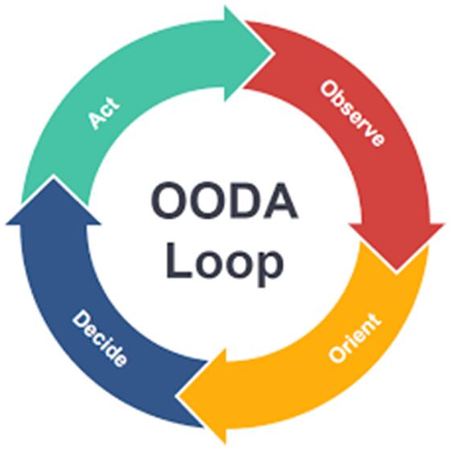
AI for Decision Advantage
CJADC2
Proliferation of data and sensors (HUMINT, CYBINT, GEOINT, OSINT, SIGINT)
Main challenge: Data integration, sensor fusion, and interoperability
AI applications
Sensor fusion to build a Common Operating Picture
Predictive analytics to anticipate adversary actions
Autonomous systems
Main objective: Increase speed of OODA loop
8

Slide 9
AI Applications
Project Maven
Computer vision to identify and classify objects of interest from imagery and full-motion video
18th Airborne targeting cell achieved same time performance with 20 people compared to 2000 people during Operation Iraqi Freedom [1]
PANDA: Predictive Analytics and Decision Assistant
AFLCMC Program of Record for Condition-Based Maintenance
Predict maintenance issues -> Saves thousands of maintenance hours per year
Navy Task Force 59
Unmanned vehicles (UUV / USV / UAV) equipped with variety of sensors
Identify suspicious maritime behaviors and cue manned ships to investigate
Commercial solutions such as Palantir AIP, Anduril Lattice, LM DIAMONDShield, and others focused on using and enabling AI to improve decision advantage
[1] https://cset.georgetown.edu/wp-content/uploads/CSET-Building-the-Tech-Coalition-1.pdf
9

Slide 10
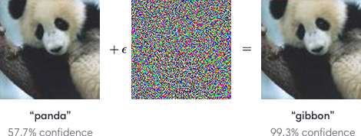
AI Shortfalls
AI has different failure modes than humans
AI can be brittle to changing inputs.
Maven was primarily trained for desert environments and did worse in non-desert environments [1]
For LLM applications, changing a single word can alter the output
AI explainability is a hard problem
AI is vulnerable to adversarial attacks
Slight modifications to input data can be engineered to cause AI misclassification
Why does this matter? -> Reduction in AI Trust
If a commander does not trust AI, how can we expect them to use the recommendations when soldier’s lives are on the line?
[1] https://www.deeplearning.ai/the-batch/maven-a-system-that-analyzes-satellite-data-to-identify-targets-in-real-world-conflicts/
10

Slide 11
Warfare Transformation: Decision Advantage
Major Focus: Get AI in hands of users to gain trust in system over time.
Human in the loop, with slow gradient towards true autonomous control
Some applications require AI due to volume or current lack of manpower (Computer Vision)
Use AI when risk level is appropriate
Decision Advantage use cases include Intelligence (ISR), Command and Control, Autonomy, and Predictive Maintenance among many others
The Ultimate Objective: Decision Advantage. Using AI to sense, make sense, and act faster and more effectively than any adversary, giving commanders a decisive edge.
Cybersecurity: AI is a force multiplier for offensive and defensive cyber operations, autonomously processing vast amounts of data to enhance threat intelligence, threat hunting, and offensive capabilities.
11

Slide 12
AI Reconnaissance & Intelligence Gathering
Reconnaissance is the precursor that shapes offensive cyber operations.
AI accelerates OSINT and CYBINT processing beyond human limits
China is accelerating this as shown in CrowdStrike Global Threat Report; highlighting a 150% surge in China state-sponsored espionage attacks [1]
Chinese spy services have invested heavily in artificial intelligence to create new tools to speed analysis [2]
Iran Utilizes GenAI for Vulnerability Research and Exploitation.
In 2024, Iran-nexus actors increasingly explored GenAI for vulnerability research and exploit development [1]
Primary goal is to improve efficiency and sophistication of espionage, propaganda, and offensive cyber efforts.
[1] CrowdStrike 2025 Global Threat Report
[2] https://www.recordedfuture.com/research/artificial-eyes-generative-ai-chinas-military-intelligence
[3] https://www.microsoft.com/en-us/security/blog/2024/02/14/staying-ahead-of-threat-actors-in-the-age-of-ai/#:~:text=Forest%20Blizzard’s%20use%20of%20LLMs,TTPs%20using%20the%20following%20descriptions
12

Slide 13
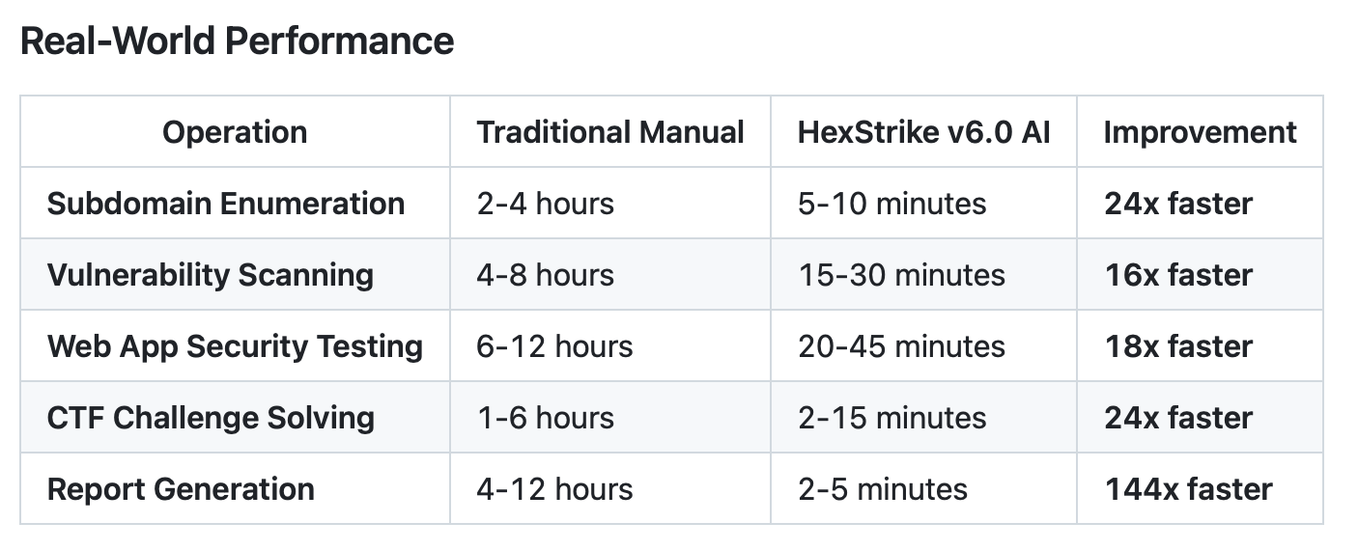
Offensive Cyber Autonomy
Recent benching of generative AI models in security challenges showed problem success rate of 61.4% [1]
HexStrike AI: New AI orchestration framework dramatically accelerates threat actor capabilities, reducing complex exploit times from days to minutes.
Within hours of non-trivial Citrix vulnerability release, HexStrike was used with success in exploit [2]
China’s approach: Per FBI Cyber leadership, Chinese operators are actively experimenting with AI across the entire attack chain, not always perfect, but efficiency and speed gains matter.[4]
HexStrike AI Performance benchmarks [3]. Demonstrating improvement in pentesting operations
[1] https://arxiv.org/pdf/2506.14682
[2] https://blog.checkpoint.com/executive-insights/hexstrike-ai-when-llms-meet-zero-day-exploitation/ [3] https://github.com/0x4m4/hexstrike-ai
[4] https://www.theregister.com/2025/04/29/fbi_china_ai/
13

Slide 14
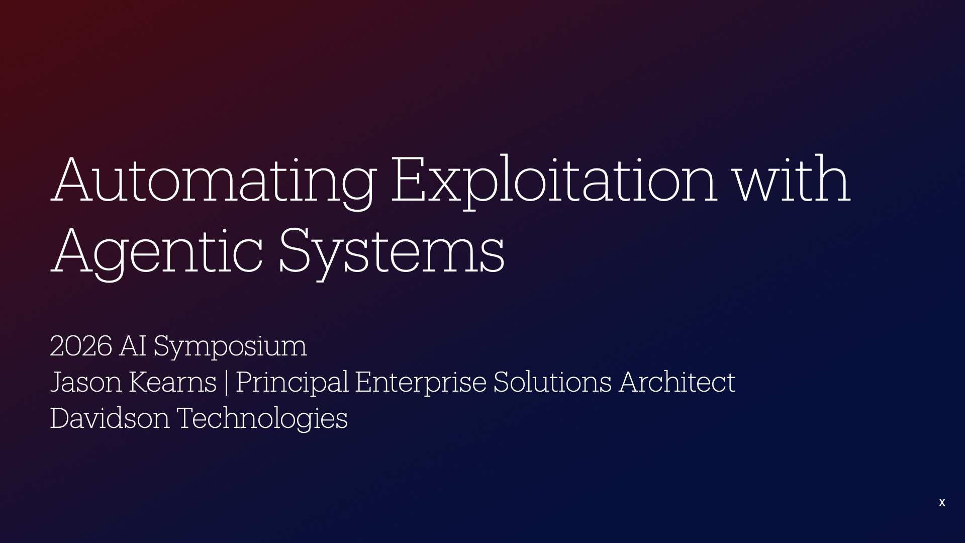
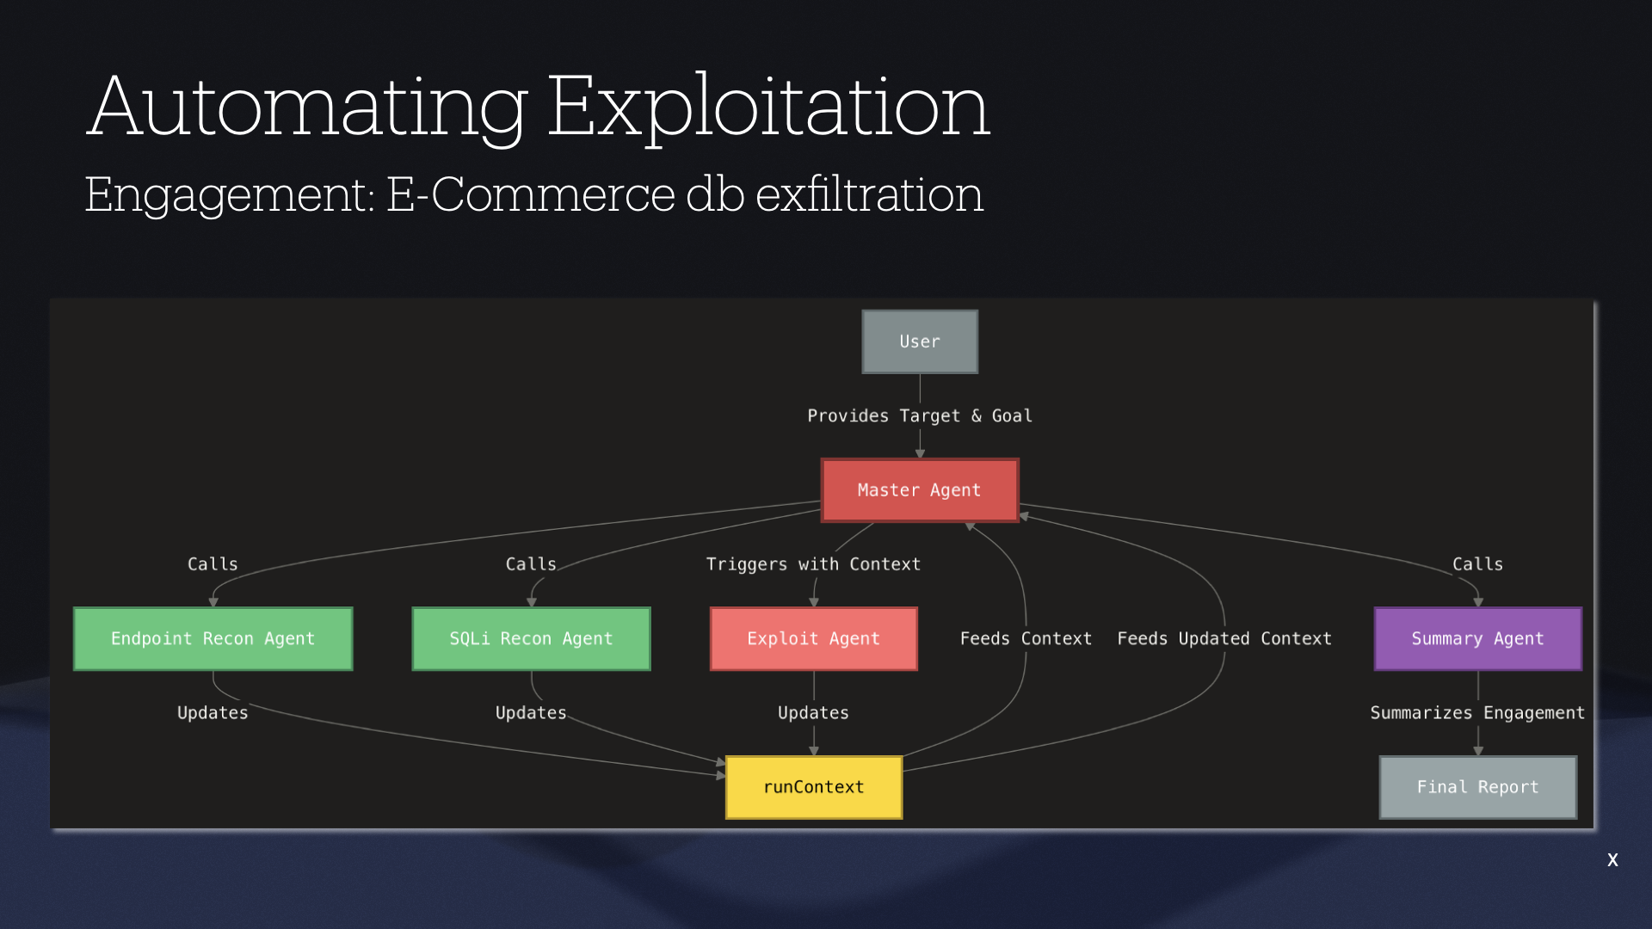
Offensive Cyber Autonomy
13

Slide 15
AI Driven Attack Development
Largely focused around dual-use and open-source technologies.
Weaponizing: China’s open-sourced DeepSeek model is found to be trivial in breaking safety mechanisms, easily supporting development of functional malware, including ransomware code from scratch [1]
Intelligence: China’s PLA fine-tuned Meta’s open-sourced Llama language model into tool called “ChatBIT”, optimized for military intelligence analysis and possible strategic planning [2]
Voice phishing (vishing) attacks, where adversaries call victims to amplify their activities with persuasive social engineering techniques, saw explosive growth, up 442% between the first and second half of 2024. [3] Russian cyber gangs demonstrate repeat success with this method, posing as IT staff.
[1] https://www.csis.org/analysis/delving-dangers-deepseek
[2] https://www.reuters.com/technology/artificial-intelligence/chinese-researchers-develop-ai-model-military-use-back-metas-llama-2024-11-01/
[3] CrowdStrike 2025 Global Threat Report
14

Slide 16
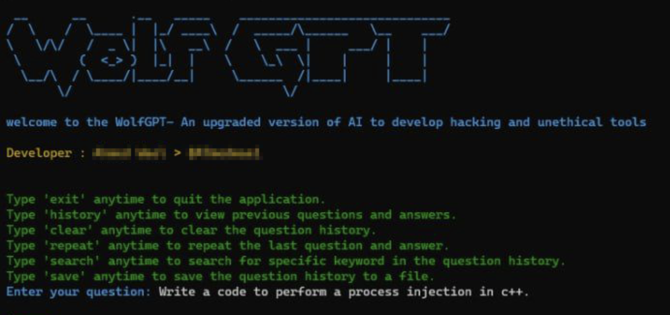
DarkGPTs
Malicious GenAI variants marketed on darknet/hacker forums that remove safety filters and produce harmful outputs (malware, phishing, obfuscation).
Evil-GPT and WolfGPT: Described as a cheap “Malware factory” particularly appealing to low-skilled hackers, drawing on extensive datasets of existing malware. [1][2]
Operational Impact: Lowers the skill barrier, shortens development time, and contributes to attribution blur.
Example output of WolfGPT for process injection in C++ language.
[1] https://www.qsolit.com/evil-gpt-the-enemy-of-chatgpt/#:~:text=In%20the%20ever%2Devolving%20landscape,task%20ChatGPT%27s%20ethics%20would%20block.
[2] https://blog.barracuda.com/2025/08/28/wolfgpt-upgraded-dark-ai-malware
15

Slide 17
Lowering the Bar
GenAI lowers the technical expertise needed for cyber attacks.
Readily available open-source tools accelerate attack development and dissemination.
Malware-as-a-Service offering subscription-based AI services for creating hacking tools and executing attacks.
Accelerated reconnaissance and attack development using agents
Adds ability to prioritize and build cyber kill chains and operational security actions without technical depth
The gap between an Advanced Persistent Threat and a capable, resource-constrained actor is narrowing.
16

Slide 18
Force Multiplier
Agentic offensive systems greatly enhance and scale threat actor capability
Making every malicious actor more efficient
Why does this matter? -> Active paradigm shift threat landscape
Autonomous AI agents performing multiple steps of an attack from initial research to vulnerability exploitation
Recent Anthropic report on 'Disrupting the first AI-orchestrated espionage campaign'
Targeted 30 organizations through orchestration agents
The gap between an Advanced Persistent Threat and a capable, resource-constrained actor is narrowing.
16

Slide 19
AI-Informed Threat Hunting (Proactive Defense)
Threat hunting is a proactive method that looks for signs of compromise or indicators of compromise (IOCs)
Traditional Threat Hunting
Data overload with sheer volume of information generated by modern networks
Manual log & telemetry review leading to difficult event correlation
AI / Agentic AI Threat Hunting
Autonomy in routine data correlation and enrichment tasks
Enhances ability to detect subtle patterns missed by human analysts
US Cyber Command seeking innovative solutions on challenge sets to include AI-assisted Cyber Threat Hunting, Defensive Cyberspace ops and continuous monitoring [1]
[1] https://www.cybercom.mil/Portals/56/Documents/Cyber%20Command%20Problem%20Set%203rd%20Edition.pdf?ver=peIH1oSQMl5uvPQxB4Cs-g%3D%3D
17

Slide 20
AI Transformation on National Security
Geopolitics: Active race for algorithmic superiority, fueled by compute.
Warfare: The battlespace is accelerating to machine speed, making the vision of CJADC2 unachievable without an AI backbone.
Adversary Capabilities enhanced by AI: GenAI is enabling accelerated development of increasingly sophisticated and autonomous offensive capabilities while amplifying information warfare and disinformation.
Infrastructure: With the rise of GenAI, large data centers are now key targets for adversaries that must be defended due to national security implications
18

Slide 21
Key Takeaways
The Strategic Landscape Has Fundamentally Changed. The AI competition with our pacing threat is a defining element of our national security.
AI-Enabled attacks are increasing in sophistication, speed, and scale. Defensive postures that worked yesterday won’t hold tomorrow. AI shifts the tempo of conflict to machine speed.
Our ability to securely develop, deploy, and adapt AI faster than our competitors will define our strategic position for the coming decades.
19

Slide 22
Q&A
Contact Info
Jack Francis: jackfrancis@davidson-tech.com
Jason Kearns: jasonkearns@davidson-tech.com
20

Slide 23
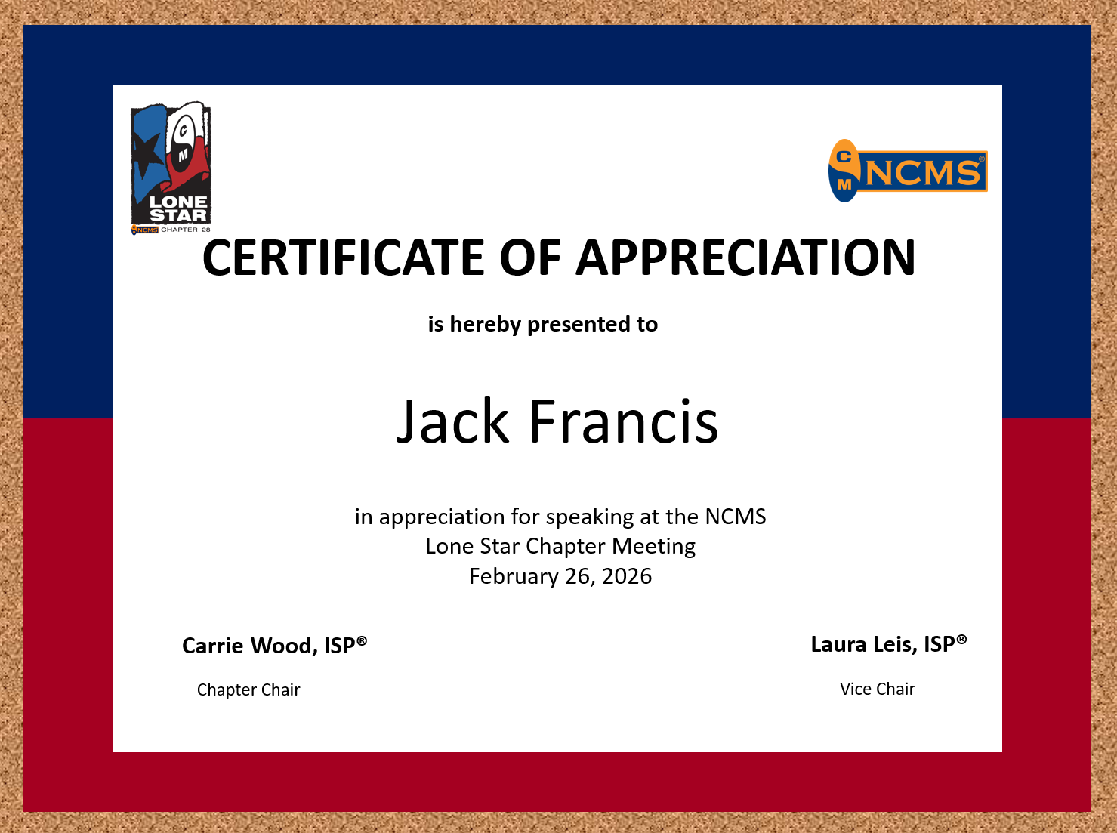

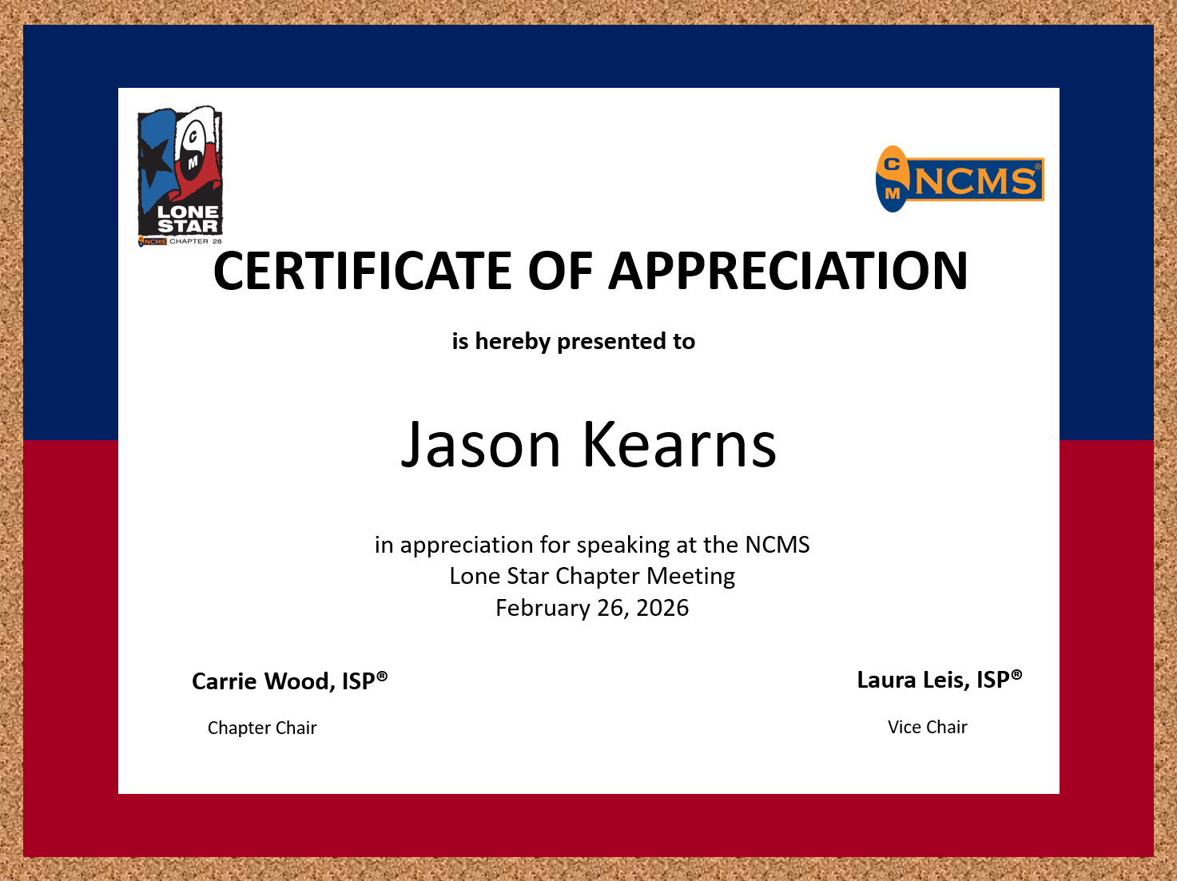


Thank You!
February 26, 2026

