Slide 1
AI for Enhanced Productivity: Mastering Prompts and a Modern Toolkit
Jack Francis, Ph.D.
AI Solutions Director – Davidson Technologies

Slide 2

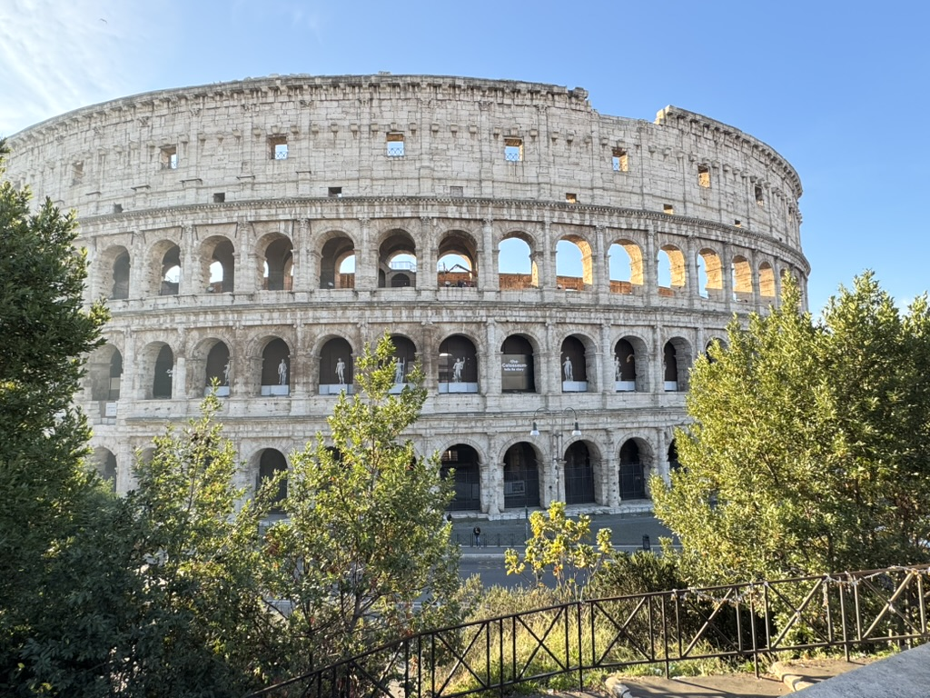
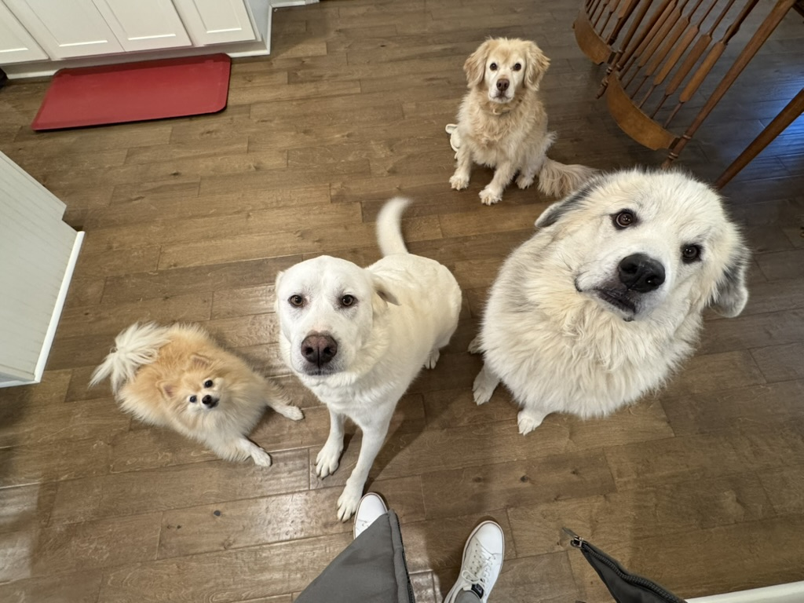
A Little About Me
Background: Ph.D. in Industrial and Systems Engineering from Mississippi State
Top 3 Core Values: Authenticity, Learning, Fun
Fun!:
Four dogs: (Pomeranian to Great Pyrenees)
Traveler: (Top 3: Tokyo, Rome, and Barcelona)
Competitor: (Chess, Golf, Card Games, anything I can win)
Why AI?: Teaching machines feels like magic

Slide 3
What we will cover today
Current LLMs -> “How do I know which LLM to use?”
Context Importance -> “Why do LLMs forget what I tell them”
Prompt Engineering -> “How do I make the LLM do what I want”
AI Tools -> “What exists besides ChatGPT”
Agentic AI -> “What comes after ChatGPT?”

Slide 4
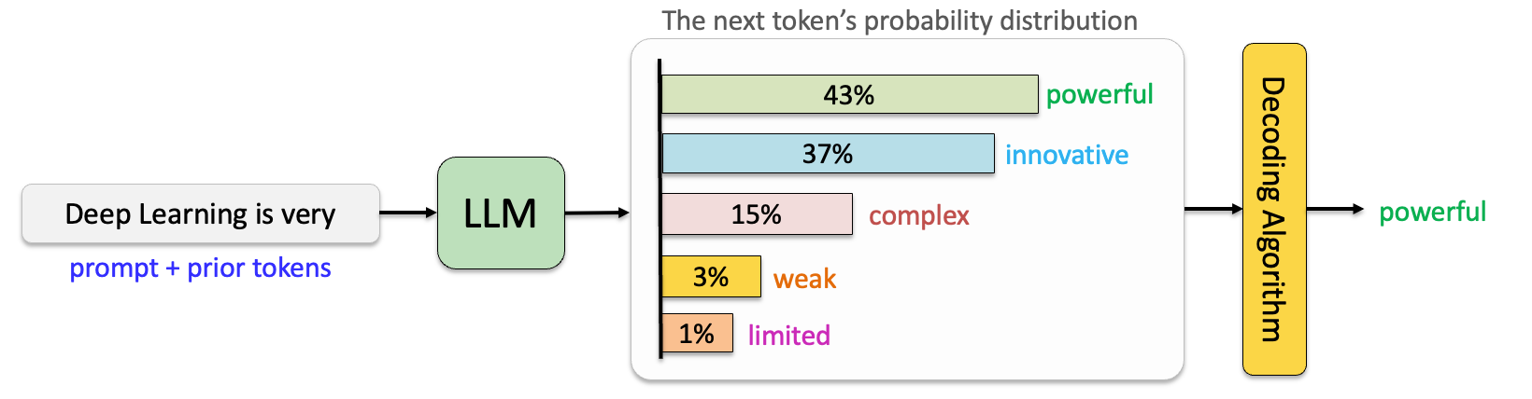
Large Language Models (LLMs)
LLMs, like ChatGPT or Gemini, work by predicting the next word based on learned patterns and the context provided
Sometimes next word is plausible but wrong -> Hallucination

Slide 5
Current LLMs
ChatGPT is a collection of LLMs, not a single LLM.
Instant models are fast and powerful for everyday work
Thinking/Pro models solve harder work tasks more effectively
Free versions are limited to Instant models or may have a few messages to Thinking model.
Generally, you must be at the $20/month tier to access Thinking/Pro
Type | OpenAI | Google | Anthropic
Instant | GPT-5.2 Instant | Gemini 3 Flash | Claude Haiku 4.5
Thinking | GPT-5.2 Thinking | Gemini 3 Thinking | Claude Sonnet 4.5
Pro | GPT-5.2 Pro | Gemini 3 Pro | Claude Opus 4.5
Smarter

Slide 6
Example of Instant vs Thinking/Pro
Help me plan a trip to Berlin in March. I have 5 days to spend and want to see many historical sites.

Slide 7

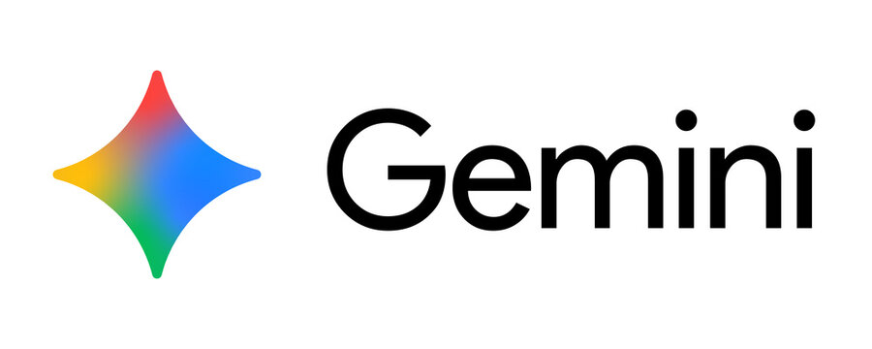

Best LLM for You
For work tasks, the difference between OpenAI, Google, and Anthropic comes down to personal preference.
Try out the Thinking / Pro variants of your favorite tool for a month
The one exception! For coding tasks, stick with GPT 5.2 Codex or Claude Opus 4.5

Slide 8
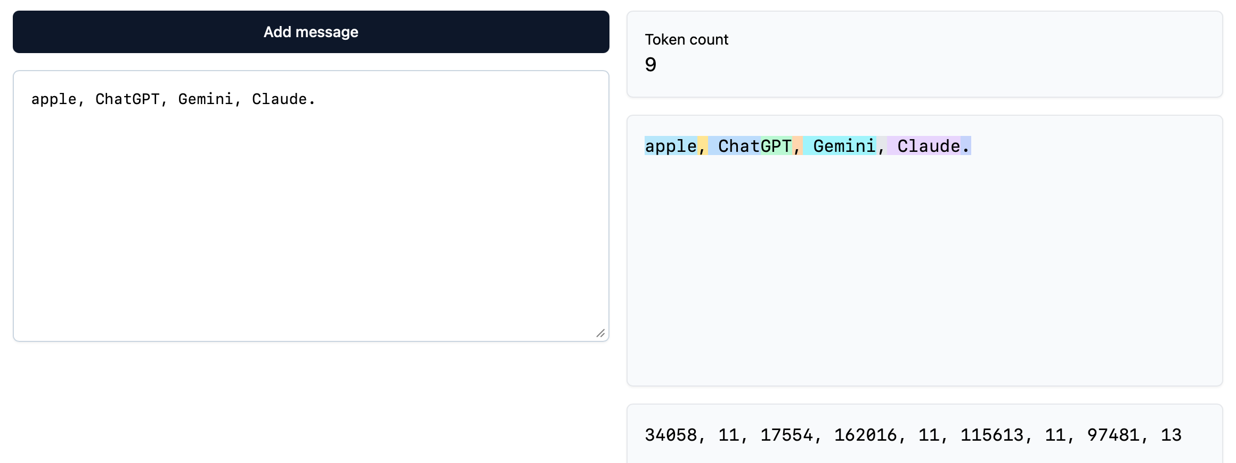
Context Window
Each LLM has a set amount of information it can process at one time called a context window.
LLMs think in “tokens”, which are like words, but sometimes words are broken into multiple tokens
1000 tokens is about 750 words. Most models have a context window of over 128,000 tokens

Slide 9
Context Clutter
If you exceed the context window, the LLM will “forget” information
For very long chats, ChatGPT, Gemini, and Claude will sometimes automatically summarize the previous messages to reduce context
Important: When the AI answers your prompt, all previous messages in the thread (both yours and the AI’s) are used as context for the answer.
If you have a single long thread with lots of messages, or discuss multiple topics in the same thread it will lead to context clutter, which will significantly increase the chance of hallucination

Slide 10
One Chat = One Project
Don’t ask for email summarization, a recipe for the potluck, and travel advice all in one chat. Risk of Hallucinations!
If your next prompt is very different from what you’ve talked about so far, start a new chat!
If the AI starts hallucinating or getting lazy, start a new chat!
Best Practice: Try to keep individual chats to less than 50 messages to keep the AI focused.
Pro Tip: If you need to keep going, ask the AI to summarize your conversation so far and start a new chat!

Slide 11
Master Prompt Formula
When LLMs were first released, prompt engineering was very important to get good results.
New LLMs have much better system prompts (default instructions)
GPT 5.2 system prompt is around 20,000 tokens (30 single space pages)
Include information on writing style, tools, and persona
Prompting is still very important for structuring output and ensuring appropriate context
Prompt Formula: Persona + Context + Task + Constraint + Format

Slide 12
Prompt Examples
Generic Prompt:
Write an email about the project delay
Persona + Context
You are a Senior Project Manager. Write an email about the Alpha Go 2 launch being delayed by 2 weeks due to server issues
You are a frustrated Network Engineer. Write an email about the Alpha Go 2 launch being delayed by 2 weeks due to server issues
All components
You are a Senior Project Manager. Write an email about the Alpha Go2 launch being delayed by 2 weeks due to server issues. Your task is to update the stakeholders. Do not apologize; focus on the solution. Use a bulleted list for the next steps.

Slide 13
Two More Superpowers
Show, Don’t Just Tell
LLMs are fantastic at following provided structure.
If you have examples of what “right” looks like, share those with the LLM
Provide a template to get consistent results
Iteration
Don’t just send one prompt! Make it a conversation
LLMs are remarkably flexible, if the output doesn’t match what you need, just ask it to fix the issues
Examples:
“Change the tone of this writing to [insert style]”
“Shorten this email”
“I have back issues so make a substitution for deadlifts”

Slide 14
Prompt Examples
Generic Prompt:
Write a bio for Sam Altman.
Show, Don’t Just Tell
Write a bio for Sam Altman. Here is an example of the exact format I want you to follow: [Name] is a [Title] who loves [Hobby]. He is currently focused on [Goal].
Iteration
That’s a little too boring. Change the tone to be witty and write it like a money-hungry pirate

Slide 15
AI Tools Buffet
Business Ops | Creativity | Productivity | Other
Deep Research - OpenAI, Gemini | Image Generation - Midjourney | AI Writing - Grammarly, Jasper | Code Generation - GitHub Copilot, Cursor
Chat with Documents - NotebookLM | Video Generation - Sora, Veo | Presentation Generation - Gamma, Beautiful.ai | AI Search Engines - Perplexity, OpenAI, Gemini
Agentic Coding - Replit, Lovable | Audio Generation - Suno | AI Note Taking - Otter AI, Fireflies | AI Data Analyst - Julius, Excel Copilot
Automation - Zapier, n8n | Text-to-Speech - ElevenLabs | Email Management - Superhuman | Intelligent Scheduling - Motion, Clockwise

Slide 16
AI Tools Buffet
Business Ops | Creativity | Productivity | Other
Deep Research - OpenAI, Gemini | Image Generation - Midjourney | AI Writing - Grammarly, Jasper | Code Generation - GitHub Copilot, Cursor
Chat with Documents - NotebookLM | Video Generation - Sora, Veo | Presentation Generation - Gamma, Beautiful.ai | AI Search Engines - Perplexity, OpenAI, Gemini
Agentic Coding - Replit, Lovable | Audio Generation - Suno | AI Note Taking - Otter AI, Fireflies | AI Data Analyst - Julius, Excel Copilot
Automation - Zapier, n8n | Text-to-Speech - ElevenLabs | Email Management - Superhuman | Intelligent Scheduling - Motion, Clockwise
What we will cover today
Will be covered in later workshops

Slide 17
Deep Research
For tasks that require significant Googling and consolidation of lots of sources of information, Deep Research is a great tool
Goes a step beyond the Thinking/Pro models by repeatedly searching the web for sources and writing 20+ page reports
Example use cases:
Competitive Analysis / Market Research
Deep dive on new technical topic area
Pro Tip: You can use Deep Research to get lots of relevant information and then use that as context for a follow-on chat

Slide 18
NotebookLM
Google tool that significantly enhances Deep Research through targeted capabilities:
Audio Overview (Generate a podcast)
Video Overview (Generate an AI-explainer video)
Flashcards (Generate study help)
Quiz (Generate questions about your content)
Slide Deck (Generate slides based on content)
Example Notebook: https://notebooklm.google.com/notebook/c0cbefb0-13d6-4aaf-b5a6-95eb302e93a2

Slide 19
Agentic Coding
Replit, Lovable, Bolt, Rork and many others provide non-coders with the ability to develop and deploy full applications
Use cases:
Small applications that only you would use
Rapidly prototyping features before showing development team
Learning to code / using tools as launchpad
A local Huntsville company uses Replit to accelerate Software Development by forcing Product Owners to build features in Replit before Engineering Team sees them.
Improves communication
Reduces development time

Slide 20
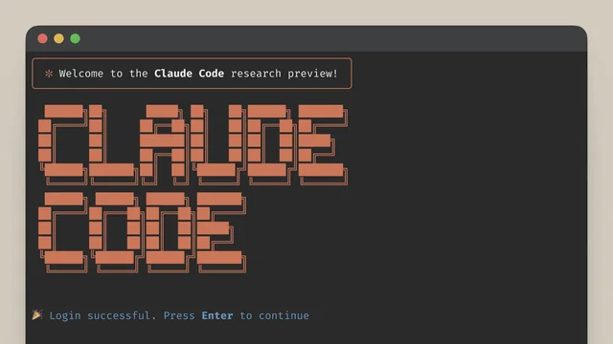
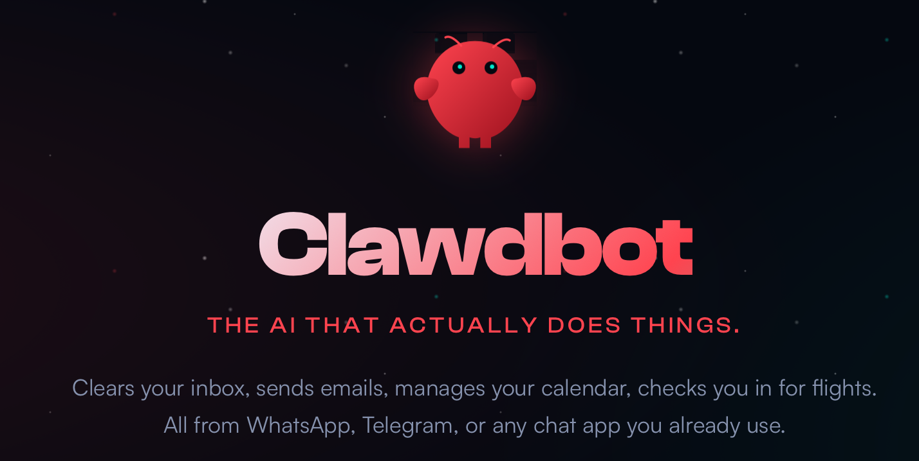
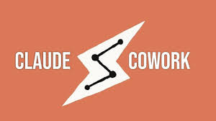
The Future is Here: Agentic AI
Chatbots to Agents
No longer just prompting; giving Agent goal to achieve
Agent has tools to use and continues to iterate

Slide 21
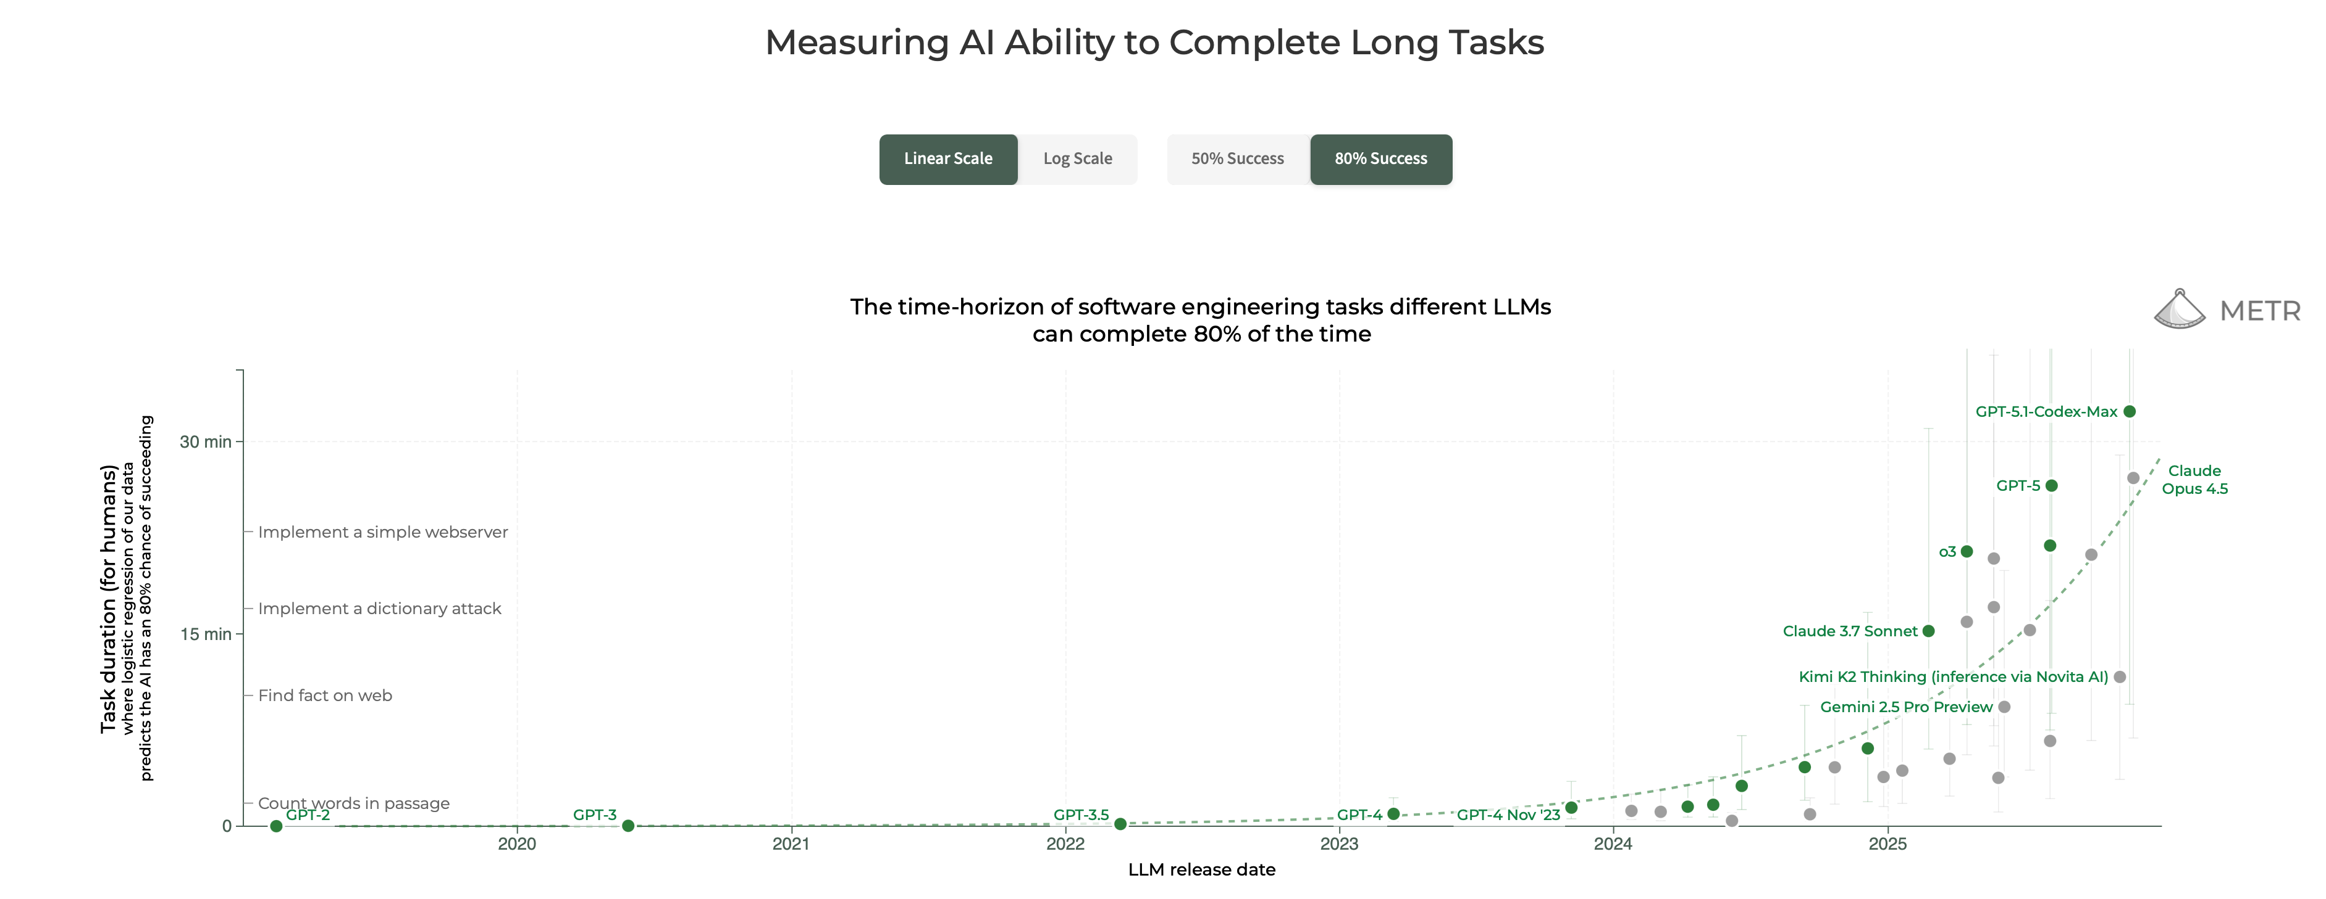
The Future is Here: Agentic AI

Slide 22
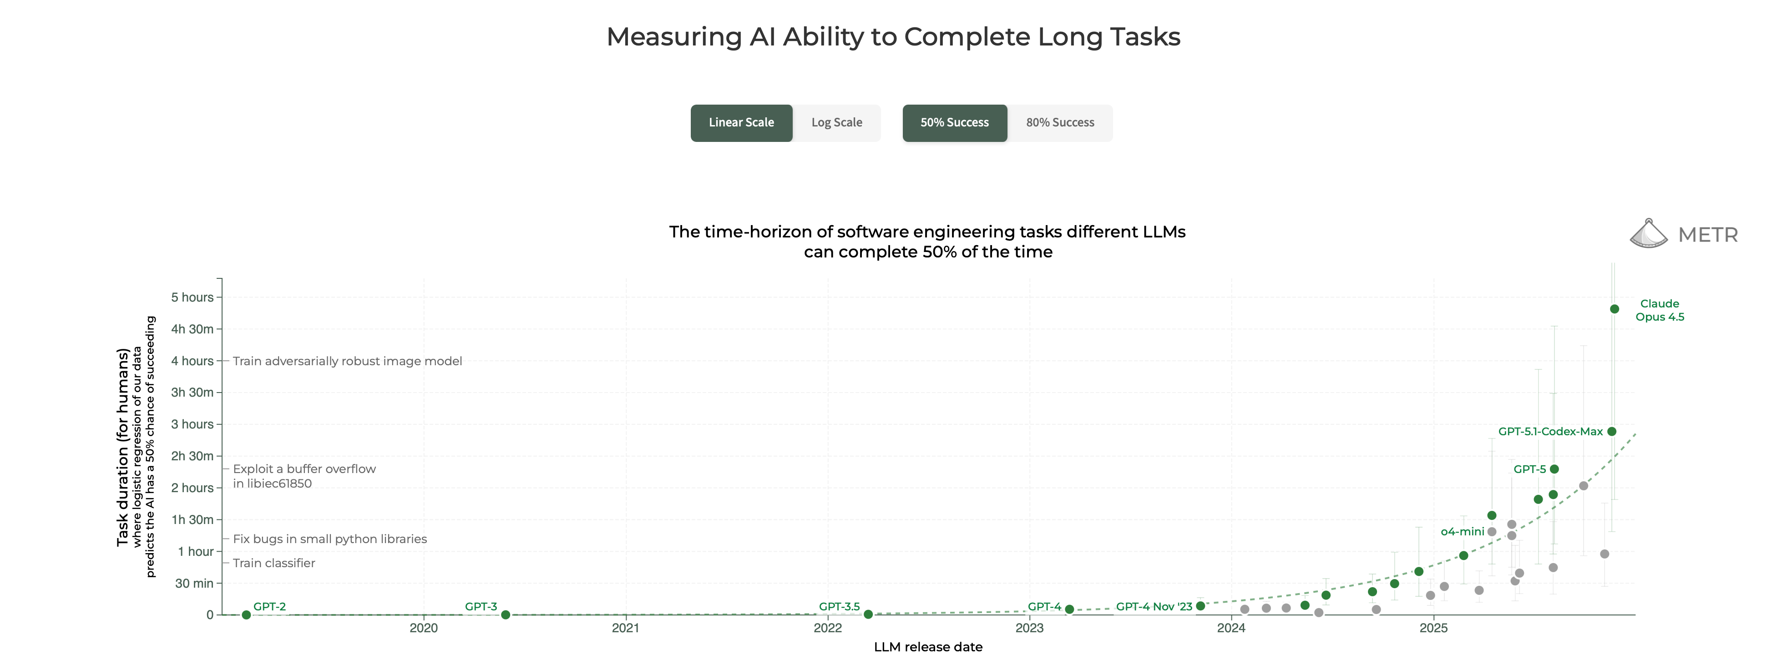
The Future is Here: Agentic AI
Chatbots to Agents
No longer just prompting; giving Agent goal to achieve
Agent has tools to use and continues to iterate

Slide 23
The Future is Here: Agentic AI
Upcoming workshops focused on Agentic AI
Tuesday 10:25 – 11:40 AM: Building your First AI Agent
Tuesday 3:10 – 4:25 PM: From Prompts to Processes
Wednesday 10:25 – 11:40AM: AI and Cyber: Automating Exploitation with AI Agents

Slide 24

Key Takeaways
AI Tools
Business Ops | Creativity | Productivity | Other
Deep Research - OpenAI, Gemini | Image Generation - Midjourney | AI Writing - Grammarly, Jasper | Code Generation - GitHub Copilot, Cursor
Chat with Documents - NotebookLM | Video Generation - Sora, Veo | Presentation Generation - Gamma, Beautiful.ai | AI Search Engines - Perplexity, OpenAI, Gemini
Agentic Coding - Replit, Lovable | Audio Generation - Suno | AI Note Taking - Otter AI, Fireflies | AI Data Analyst - Julius, Excel Copilot
Automation - Zapier, n8n | Text-to-Speech - ElevenLabs | Email Management - Superhuman | Intelligent Scheduling - Motion, Clockwise
Current LLMs
Try Thinking/Pro
OpenAI/Google/Anthropic all about the same
Context Importance
One Chat = One Project
Limit to ~50 messages
Prompt Engineering
Prompt Formula: Persona + Context + Task + Constraint + Format
Show Don’t Just Tell and Iterate!
AI Tools
Deep Research, NotebookLM, Replit
Agentic AI
Expect to see Agentic AI tools continue to improve
LinkedIn
Contact Info:
jackfrancis@davidson-tech.com
jackbfrancis@gmail.com

