Slide 1

From Idea
to Impact:
A Leader’s
Guide to
Rapid Prototyping
with Replit

Slide 2

TELL
SHOW

Slide 3


Slide 4
8x
3x
20%
WEBSITE CONVERSION
DEAL CONVERSION
FASTER SALES CYCLES
3.05% -> 24.35%
3.10% -> 10.10%
33 Days -> 27 Days
SOURCE: STORYLANE & FACTORS.AI STUDY, N=110,000 SESSIONS

Slide 5

BUREAUCRACY

Slide 6

WHERE IDEAS LIVE
WHY THEY STAY THERE
IN HEADS
IN INBOXES
MEETINGS
COMMITTEES
6-MONTH WAIT
THE COST OF VALIDATION IS HIGHER THAN THE WILL TO INNOVATE

Slide 7

17%
INNOVATION PROJECT SUCCESS RATE
SOURCE: STRATEGYN 2010 STUDY

Slide 8
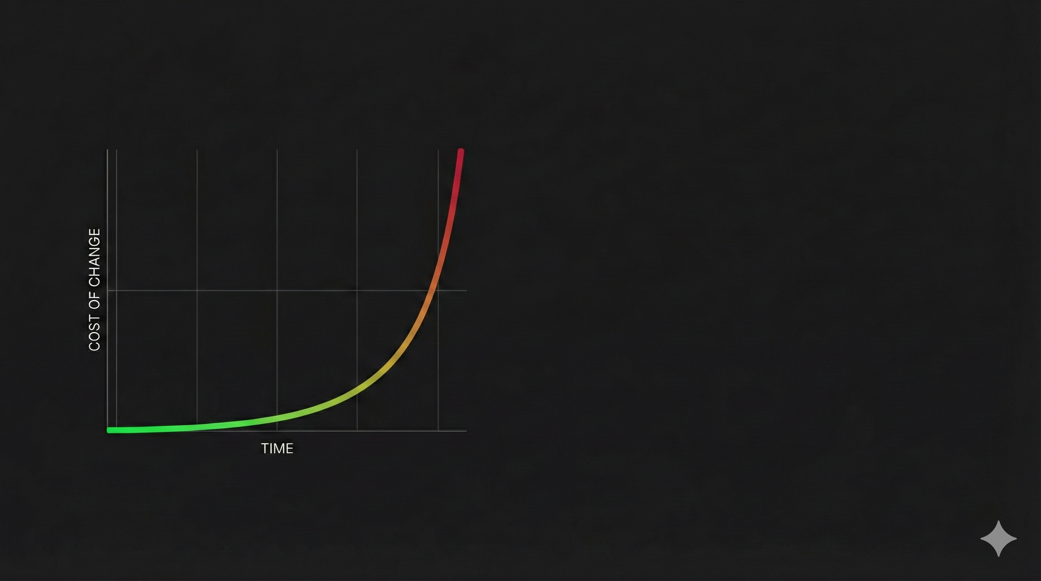
$100
PRODUCTION
$10
QA / TEST
$1
PROTOTYPE

Slide 9


Slide 10

MONEY
TIME
SIGNAL

Slide 11

NATURAL LANGUAGE -> DEPLOYED APPLICATION

Slide 12
Video Link: https://www.youtube.com/watch?v=UGWGpzRPOh0

Slide 13

VIBE CODING

Slide 14
DEMO

Slide 15

MONEY
TIME
SIGNAL

Slide 16

PROTOTYPE FIRST WORKFLOW

Slide 17

IT’S YOUR TURN TO BUILD

